Slide 1
How to Treat Liver Disease with TCVM Food Therapy

Slide 2
Liver Pathology in TCVM
Pi juan, fatigue
Xie tong, rib side pain
E xin, nausea
Na dai, torpid intake, inappetance
Xie xie, diarrhea
Zheng jia, concretions and conglomerations
Huang dan, jaundice
Xiao xue, emaciation
Zu zhong, foot swelling

Slide 3
From Pathology, Which Food Categories Most Important?
Qi Tonics
  Beef, Carrot, Chicken, Date, Fig, Lentil, Mackerel, Microalgae, Molasses, Oats, Rutabaga, Sweet Potato, Pumpkin and Squash
Qi Circulators
  Basil, Cardamom, Carrot, Cayenne, Clove, Coriander, Garlic, Hawthorn Berry and Turmeric
Blood Circulators
  Chestnut, Chili Pepper, Chive, Crab, Hawthorn Berry, Peach, Ginger, Turmeric and Vinegar

Slide 4
From Pathology, Which Food Categories Most Important?
Foods to Relieve Stagnation
  Pungent and Raw Foods
    Watercress, onions, mustard greens, turmeric, basil, bay, cardamom, marjoram, cumin, fennel, ginger, black pepper, rosemary, various mints, sprouted grains, beans, seeds, fresh vegetables, fruit
  Foods which Harmonize the Liver
    Honey, apple cider vinegar, licorice root, molasses, barley malt
  Bitter and Sour Food
    Rye, romaine lettuce, asparagus, amaranth, quinoa, alfalfa, citrus peel, dandelion root, bupleurum, milk thistle, chamomile
  Detoxifying and Cooling
    Mung beans, celery, seaweeds, cucumber, watercress, millet, mushrooms, daikon radish, rhubarb root
  Accelerate Liver Rejuvenation
    Chlorophyll-rich foods, micro-algae, parsley, kale, watercress, alfalfa, collard greens

Slide 5
From Pathology, Which Food Categories Most Important?
Phlegm Regulating Foods
  Almond, Apple Peel, Garlic, Licorice, Marjoram, Mushroom, Black and White Pepper, Peppermint, Plantain, Seaweed, Shitake Mushroom, Shrimp, Tea, Walnut and Watercress
Damp Regulating Foods
  Alfalfa, Barley, Garlic, Green Tea, Job’s tears, Kidney Bean, Mackerel, Mushroom, Parsley, Pumpkin, Rutabaga, Rye and Turnip

Slide 6
Liver Pathoetiology in TCVM
Li Qi, perverse Qi, refers to contagious evil Qi
  Damp and Hot in nature, lodges in the Blood
  Damages Blood, consumes Qi
  Obstructs the free flow of Qi and Blood
Inappropriate Diet
  Damages Spleen, engenders Dampness
  Cooks and transforms Heat
Emotional Stress
  Chronic Stagnation transforms Heat
  Stressed Liver attacks Spleen
  Spleen Deficiency engenders Damp which binds with Heat

Slide 7
Liver Pathoetiology in TCVM
Damp Heat
  Obstructs free flow of Qi and Blood
  Heat consumes Yin, Blood and Fluids
  Results in Yin or Blood Deficiency
  Engenders Phlegm and results in Stasis
Damp Heat sometimes transforms into Fire
  Damages Blood and Yin
Chronic Spleen damage leads to Kidney damage
Damp commonly predominates over Heat
  Heat signs may be hidden or minimal

Slide 8
TCVM Patterns correlated with Western Biomedical Hepatopathies
Liver Qi Stagnation
Liver-Spleen Disharmony
Spleen-Stomach Damp-Heat
Liver-Gallbladder Damp-Heat
Damp-Heat transforming into Fire
Damp-Heat injuring Yin and Blood
Phlegm Nodulation
Liver-Kidney Yin Deficiency
Spleen-Kidney Yang Deficiency
Internal Cold-Damp

Slide 9
From Bian Zheng, What Food Categories Will Be Most Important?
Foods to Soothe the Liver and Relieve Stagnation
  Pungent and Raw Foods
    Watercress, onions, mustard greens, turmeric, basil, bay, cardamom, marjoram, cumin, fennel, ginger, black pepper, rosemary, various mints, sprouted grains, beans, seeds, fresh vegetables, fruit
  Foods which Harmonize the Liver
    Honey, apple cider vinegar, licorice root, molasses, barley malt
  Bitter and Sour Foods
    Rye, romaine lettuce, asparagus, amaranth, quinoa, alfalfa, citrus peel, dandelion root, bupleurum, milk thistle, chamomile
  Detoxifying and Cooling
    Mung beans, celery, seaweeds, cucumber, watercress, millet, mushrooms, daikon radish, rhubarb root
  Accelerate Liver Rejuvenation
    Chlorophyll-rich foods, micro-algae, parsley, kale, watercress, alfalfa, collard greens

Slide 10
From Bian Zheng, What Food Categories Will Be Most Important?
Qi Tonics
  Beef, Carrot, Chicken, Date, Fig, Lentil, Mackerel, Microalgae, Molasses, Oats, Rutabaga, Sweet Potato, Pumpkin and Squash
Damp Regulating Foods
  Alfalfa, Barley, Garlic, Green Tea, Job’s tears, Kidney Bean, Mackerel, Mushroom, Parsley, Pumpkin, Rutabaga, Rye and Turnip

Slide 11
Again, What Food Categories
Will Be Most Important?
Heat-clearing Foods
  Asparagus, Bamboo Shoot, Banana, Kelp, Lettuce, Millet, Peppermint, White Potato and Tofu
Yin Tonics
  Apple, Asparagus, Cheese, Chicken Egg White, Duck, Honey, Mango, Milk, Peas, Pineapple, Pork, Rabbit, String Bean, and Tofu
Yang Tonics
  Basil, Cinnamon Bark, Clove, Fennel Seed, Fenugreek Seed, Garlic, Dried Ginger, Kidney, Lamb, Rosemary, Shrimp, and Walnut

Slide 12
Liver Patterns: Liver Qi Stagnation
Common Signs
  Lateral costal distension and pain
  tendency to sigh
  Irritability
  burping and belching
  menstrual irregularities
  normal or dark tongue with normal coat
  tight to wiry pulse
Treatment Principles: Soothe the Liver, Move Liver Qi, Stop Pain

Slide 13

Liver Qi Stagnation

Slide 14
Liver Patterns: Liver Qi Stagnation
Chai Hu Shu Gan San Bupleurum Course the Liver Powder
  Chai Hu, Radix Bupleuri
  Bai Shao, Radix Albus Paeoniae Lactiflorae
  Xiang Fu, Rhizoma Cyperi Rotundi
  Zhi Ke, Fructus Citri Aurantii
  Chuan Xiong, Radix Ligustici Wallichii
  Gan Cao, Radix Glycyrrhizae
Actions: Disperses Liver Qi, harmonizes Blood, relieves pain

Slide 15
Liver Qi Stagnation
Liver Happy (B3905)
  Xiang fu zi cyperus
  Qing pi immature tangerine peel
  Bai shao yao white peony
  Mu xiang saussurea
  Bo he peppermint
  Chai hu bupleurum
  Mu dan pi moutan
  Zhi zi gardenia
  Dang gui angelica sinensis
  Gan cao licorice
Actions: Soothe Liver Qi, clear Heat, resolve Stagnation

Slide 16
Liver Happy Formula Analysis
Chief herbs Xiang Fu Zi, Cyperus, Qing Pi, Immature Citrus, and Bai Shao Yao, Peony soothe the Liver and resolve Stagnation
Assistants Mu Xiang, Saussurea, Bo He, Mentha, and Chai Hu, Bupleurum move Liver Qi and cool the Liver
Mu Dan Pi, Moutan and Zhi Zi, Gardenia are both cooling and heat clearing
Dang Gui, Angelica sinensis nourishes and moves Blood
Gan Cao, licorice is a sweet, warm envoy

Slide 17
“Liver Happy” Food Therapy
Foods to Soothe the Liver and Relieve Stagnation
  Pungent and Raw Foods
    Watercress, onions, mustard greens, turmeric, basil, bay, cardamom, marjoram, cumin, fennel, ginger, black pepper, rosemary, various mints, sprouted grains, beans, seeds, fresh vegetables, fruit
  Foods which Harmonize the Liver
    Honey, apple cider vinegar, licorice root, molasses, barley malt
  Bitter and Sour Foods
    Rye, romaine lettuce, asparagus, amaranth, quinoa, alfalfa, citrus peel, dandelion root, bupleurum, milk thistle, chamomile
  Detoxifying and Cooling
    Mung beans, celery, seaweeds, cucumber, watercress, millet, mushrooms, daikon radish, rhubarb root

Slide 18
“Liver Happy” Food Therapy
Detoxifying and Cooling
  Mung beans, celery, seaweeds, cucumber, watercress, millet, mushrooms, daikon radish, rhubarb root
Blood Tonics
  aduki bean, apricot, avocado, barley, beef, beetroot, black bean, black sesame, bone marrow, chicken egg, corn, dandelion, dark leafy greens, date, dang gui, egg yolk, fig, grape, Job’s tears, kelp, kidney bean, liver, longan, Microalgae, molasses, mulberry nettle, oats, oyster, parsley, pollen, pork, rice, salmon, sardine, soy milk, spinach, sweet rice, watercress

Slide 19
Liver Happy Food
Crab 4 oz
Beef liver 2 oz
Pork 4 oz
Mung beans 4 oz
Mushroom 1 cup
Mustard greens 1 cup
Turmeric ¼ tsp
Barley 1 cup
Honey ¼ cup
Calcium 1000 mg
Calories 1079 P-F-C 34/13/56

Slide 20
Liver Patterns:
Liver-Spleen Disharmony
Common signs
  Chest, breast, stomach and rib distension and pain
  Irritability
  Frequent sighing
  Fatigue
  Lack of strength
  Cold paws
  Possible reduced food intake
  Loose stools
  Tongue is swollen, usually pale, may be dark
  Thin, weak, tight to wiry pulse
Treatment Principles: Soothe the Liver, Fortify Spleen

Slide 21
Liver-Spleen Disharmony
Xiao Yao San, Rambling Powder
  Chai hu bupleurum
  Dang gui angelica sinensis
  Bai shao yao white peony
  Bai zhu white atractylodes
  Fu ling poria
  Bo he peppermint
  Wei jiang roasted ginger
  Zhi gan cao honey-fried licorice
Actions: Disperses Liver Qi, relieves stagnation, tonifies Spleen Qi, nourishes Blood

Slide 22
Xiao Yao San Formula Analysis
The chief herb Chai Hu, Bupleurum, relieves Liver constraint
Deputies Dang Gui, Angelica sinensis, and Bai Shao Yao, Peony, nourish Blood to soften Liver
Assistants Bai Zhu, Atractyoldes, and Fu ling, Poria, strengthen the Spleen and T & T function
Assistants Zhi Gan Cao, honey-fried Licorice and Bai Shao Yao, Peony, moderate spasmodic abdominal pain
Envoy Wei Jiang, Zingiber harmonizes the Stomach
Envoy Bo He, Mentha harmonizes and cools Liver

Slide 23
“Xiao Yao San” Food Therapy
Foods to Soothe the Liver and Relieve Stagnation
  Pungent and Raw Foods
    Watercress, onions, mustard greens, turmeric, basil, bay, cardamom, marjoram, cumin, fennel, ginger, black pepper, rosemary, various mints, sprouted grains, beans, seeds, fresh vegetables, fruit
  Foods which Harmonize the Liver
    Honey, apple cider vinegar, licorice root, molasses, barley malt
  Bitter and Sour Foods
    Rye, romaine lettuce, asparagus, amaranth, quinoa, alfalfa, citrus peel, dandelion root, bupleurum, milk thistle, chamomile
  Detoxifying and Cooling
    Mung beans, celery, seaweeds, cucumber, watercress, millet, mushrooms, daikon radish, rhubarb root

Slide 24
“Xiao Yao San” Food Therapy
Qi Tonics
  Beef, Carrot, Chicken, Date, Fig, Lentil, Mackerel, Microalgae, Molasses, Oats, Rutabaga, Sweet Potato, Pumpkin and Squash
Damp Regulating Foods
  Alfalfa, Barley, Garlic, Green Tea, Job’s tears, Kidney Bean, Mackerel, Mushroom, Parsley, Pumpkin, Rutabaga, Rye and Turnip

Slide 25
Xiao Yao San Food
Mung beans 4 oz
Cardamom 1 tsp
Fennel 1 tsp
Beef liver 2 oz
Beef (round roast) 4 oz
Zucchini 4 oz
Pumpkin ½ cup
Ginger 5 slices
Honey ¼ cup
Apple Cider vinegar 1 oz
Millet 4 oz
Mushroom 1 cup
Calcium 750 mg
Calories 705 P-F-C 18/7/80

Slide 26
Liver Patterns: Liver-Gallbladder Damp-Heat
Common signs
  Lateral costal pain
  Low-grade fever
  Red eyes
  Headache
  Bitter taste in mouth
  Reduced appetite
  Nausea and vomiting
  Reddish-yellow urine
  Possible jaundice
  Red tongue with yellow coating
  Tight to wiry, slippery rapid pulse
Treatment Principles: Soothe the Liver and Gallbladder, Clear Heat and Eliminate Dampness

Slide 27
Liver-Gallbladder Damp-Heat
Long Dan Xie Gan Tang, Gentiana Drain the Liver Decoction
  Long Dan Cao, gentiana 6g
  Huang Qin, scutelaria 9g
  Zhi Zi, gardenia fruit 9g
  Mu Tong, akebia 6g
  Ze Xie, alisma 9g
  Chai Hu, bupleurum 6g
  Sheng Di Huang , unprocessed rehmannia 6g
  Dang Gui, angelica sinensis 3g
  Sheng Gan cao, raw licorice 6g
Actions: Purge excessive Damp-Heat from Liver and Gallbladder, eliminates Damp-Heat from Lower Burner

Slide 28
Long Dan Xie Gan Tang Food
Mackerel 4 oz
Kidney bean 4 oz
Mushroom 1 cup
Radish ½ cup
Rye ½ cup
Lamb 4 oz
Crab 4 oz
Garlic 1 clove
Clove ½ tsp
Beef 4 oz
Beef liver 2 oz
Calcium 1500 mg
Calories 1191 P-F-C 43/24/34

Slide 29
Liver Patterns: Damp-Heat injuring Ying and Blood
Common Signs
  Lateral costal pain, Abdominal distension
  Bitter taste in mouth, Malodorous breath
  Dry tongue and lips
  Possible red eyes
  Headache, Agitation, Easily angered
  Insomnia
  Red, turbid urine
  Epistaxis, bleeding gums, spontaneous bleeding
  Malodorous loose stools
  Red tongue with slimy yellow coat
  Surging, slippery, rapid pulse
Treatment Principles: Disinhibit Dampness, Clear Heat, Clear Ying, Cool Blood

Slide 30
Damp-Heat injuring Ying and Blood
Yin Chen Hao Tang, Capillaris Decoction
  Clears Heat, drains Damp, eliminates jaundice
Qing Ying Tang, Clear the Nutritive Level Decoction
  Clear Heat from Nutritive Level, relieve toxicity, nourishes Yin, promotes Blood circulation
Yin Hua Jie Du Tang, Lonicera Resolve Toxins Decoction
  Clears Heat, relieves toxicity, drains Fire, cools the Blood

Slide 31
Damp-Heat injuring Ying and Blood
Qing Ying Tang, Clear the Ying Level Decoction
  Xi Jiao, Cornu Rhinoceri 30g
    Substitute Shui Niu Jiao, water buffalo horn X10
  Xuan Shen, Scrophularia 9g
  Sheng Di Huang 15g
  Mai Men Dong 9g
  Jin Yin Hua, Flos Lonicerae Japonicae 9g
  Lian Qiao, Fructus Forsythiae Suspensae 6g
  Huang Lian, Rhizoma Coptidis 5g
  Dan Zhu Ye 3g
  Dan Shen 6g
Actions: Clear Heat from Nutritive Level, relieve toxicity, nourishes Yin, promotes Blood circulation

Slide 32
Damp-Heat injuring Ying and Blood
Yin Hua Jie Du Tang, Honeysuckle Decoction to Relieve Toxicity
  Jin Yin Hua, Flos Lonicerae Japonicae
  Zi Hua Di Ding, Herba Violae Yedoensitis
  Xi Jiao, Cornu Rhinoceri
    Substitute Shui Niu Jiao, water buffalo horn X10
  Chi Fu Ling, Sclerotium Poriae Cocos Rubrae
  Lian Qiao, Fructus Forsythiae Suspensae
  Mu Dan Pi, Cortex Moutan Radicis
  Huang Lian, Rhizoma Coptidis
  Xia Ku Cao, Spica Prunellae Vulgaris
Actions: Clears Heat, relieves toxicity, drains Fire, cools the Blood

Slide 33
Yin Hua Jie Du Tang Food
Spinach 1 cup
Apple Cider Vinegar 1 oz
Clams 4 oz
Carrots ½ cup
Watercress 1 oz
Tomatoes 4 oz
Millet 2 oz
Lettuce 3 ox
Kelp 2 oz
Calcium 300 mg
Calories 338 P-F-C 43-11-46

Slide 34
Phlegm Nodulation
Common Signs
  Profuse Phlegm
  Chest and abdominal fullness
  Fatigue
  Lack of strength
  Lassitude of spirit
  Inappetance
  Possible nausea and vomiting
  Tendency to loose stools with mucus in stools
  Subdermal nodulations or lateral costal lumps
  Slimy tongue coat
  Slippery tight to wiry pulse
Treatment Principles: Fortify the Spleen and transform Phlegm, scatter nodulation and disperse accumulation

Slide 35
Phlegm Nodulation
Liu Jun Zi Tang, Six Gentlemen Decoction
  Ren Shen, Ginseng
  Bai Zhu, White Atractylodes
  Fu Ling, Poria
  Chen Pi, Tangerine Peel
  Ban Xia, Pinellia Tuber
  Zhi Gan Cao, Honey-fried Licorice
Functions: Tonify the Spleen, resolve Dampness, transform Phlegm, stop vomiting

Slide 36
Liu Jun Zi Tang Formula analysis
Tonify Spleen Qi with the herbal formula Si Jun Zi Tang or Four Gentlemen Decoction
  the chief herb Panax ginseng ren shen is sweet, warm and tonifies Spleen Qi
  the deputy herb Atractylodis macrocephalae bai zhu is bitter, warm and strengthens Spleen Qi and dries Dampness
  the assistant herb Poria cocos fu ling is sweet, bland and leeches out Dampness and mildly Tonifies Spleen Qi
  Chen Pi, tangerine peel, and Ban Xia, pinellia, regulate Qi, harmonize Spleen and Stomach, resolve Phlegm and stop vomiting
  the envoy Glycyrrhizae uralensis gan cao is warm, sweet and warms and regulates the middle burner

Slide 37
“Liu Jun Zi Tang” Food Therapy
  Warm, sweet Chicken which enters the Spleen and Stomach to Tonify Qi
  Warm, sweet Oats to strengthen the Spleen and dry Dampness
  Or neutral, bitter Rye to drain Dampness and Water from the Spleen Warm, sweet Chicken which enters the Spleen and Stomach to Tonify Qi
  Cool, sweet Mushroom to leech Dampness and mildly tonify Spleen Qi
  Neutral, sweet and sour Coriander to direct the actions to the middle burner and mildly warm the Spleen and Stomach
  Use acrid, warm, aromatic Cardamom (Sha Ren) to reduce Phlegm or vomiting

Slide 38
Lui Jun Zi Tang Food
Chicken breast cooked ½ breast
Instant oats, cooked 2 oz
Rye, cooked 1 oz
Mushrooms 1 cup
Coriander ¼ tsp
Cardamom ¼ tsp
Radicchio 2 oz
Ginger 1 tsp
Honey 1 oz
Calcium 400 mg
Calories 390 P-F-C 35-11-54

Slide 39
Phlegm Nodulation
Max Formula, B2022
  Zhe Bei Mu, Fritillaria
  Mu Li, Ostrea
  Xia Ku Cao, Prunella
  Xuan Shen, Scrophularia
  Tian Hua Fen, Trichosanthes
  Jie Geng, Platycodon
  Da Huang, Rhubarb
  Bai Zhi, Angelica
Functions: Soften the hardness and clear nodules

Slide 40
“Max Formula” Formula analysis
Zhe Bei Mu, Fritillaria and Mu Li, Ostrea both soften hardness and clear masses and nodules
Assistants Xia Ku Cao, Prunella, Xuan Shen, Scrophularia, and Tian Hua Fen, Trichosanthes all Clear Heat, Cool Blood and generate fluids
Jie Geng, Platycodon transforms Phelgm
Da Huang, Rhubarb clears stagnation and Heat
Bai Zhi, Angelica dahurica relieves pain

Slide 41
“Max Formula” Food Therapy
Which foods energies soften hardness and resolve nodules? Which foods?
Name at least one grain, fruit and vegetable which clears Heat and generates fluids
Phlegm-resolving foods
  Almond, Apple Peel, Garlic, Licorice, Marjoram, Mushroom, Black and White Pepper, Peppermint, Plantain, Seaweed, Shitake Mushroom, Shrimp, Tea, Walnut and Watercress
Da Huang, Rhubarb clears stagnation and Heat, particularly in the ST/LI

Slide 42
Max’s Formula Food
Mushroom 1 cup
Radish 1 oz
Kelp 2 oz
Crab 4 oz
Spinach 1 cup
Lettuce 2 oz
Garlic 2 cloves
Calcium 150 mg
Calories 172 P-F-C 56-11-27

Slide 43
Liver Patterns:
Liver-Kidney Yin Deficiency
Common Signs
  Lateral costal pain
  Lumbar and stifle weakness and pain
  Dry mouth and throat
  Heat in chest center and paws
  Insomnia
  Dizziness
  Emaciation
  Dry eyes
  Red tongue with little to no coat
  Fine and rapid or wiry pulse
Treatment principle: Nourish Liver and enrich Kidneys

Slide 44
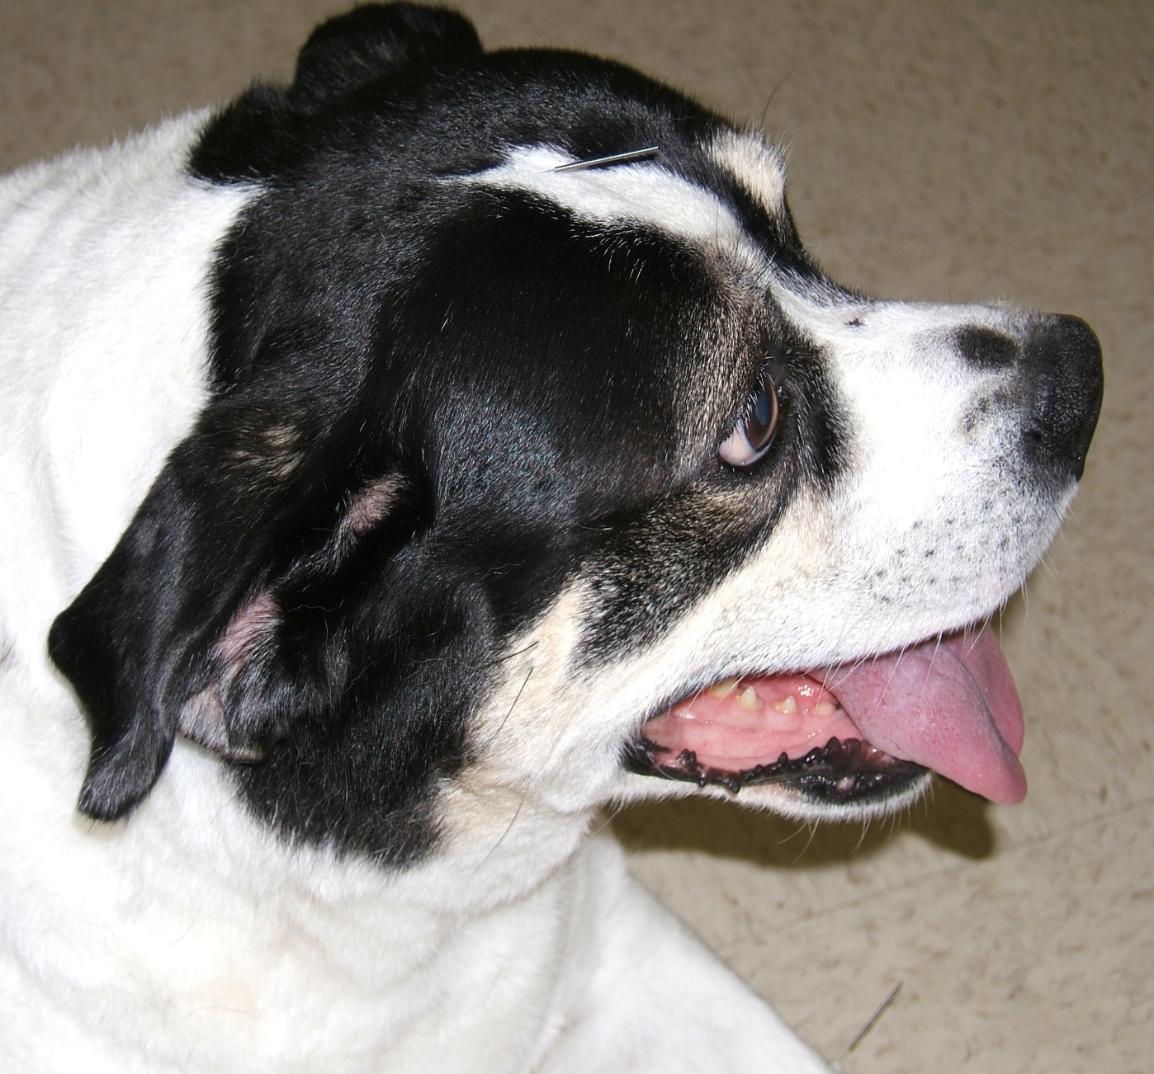
Liver-Kidney Yin Deficiency

Slide 45
Liver-Kidney Yin Deficiency
Yi Guan Jian, One Link Brew
  Sha shen, Glehnia root
  Mai men dong, Ophiopogon
  Dang gui, Angelica sinensis
  Sheng di huang, uncooked rehmannia
  Gou qi zi, Lycium fruit
  Chuan lian zi, Melia
Functions: Nourishes the Kidney and Liver Yin, soothes the Liver, relieves Qi Stagnation

Slide 46
Yi Guan Jian Formula Analysis
Chief herbs Sheng Di Huang, unprocessed Rehmannia and Gou Qi Zi, Lycium, soften the Liver by nourishing Blood
Deputies Sha Shen, Glehnia,, and Mai Men Dong, Ophiopogon, enrich and nourish Stomach and Lung Yin
Assistant Dang Gui, Angelica sinensis nourishes and invigorates Blood
Envoy Chuan Lian Zi, Melia disperses constrained Liver Qi and reduces pain

Slide 47
“Yi Guan Jian” Food therapy
Which foods nourish Liver Blood or Blood?
  Blood Tonics:
    aduki bean, apricot, avocado, barley, beef, beetroot, black bean, black sesame, bone marrow, chicken egg, corn, dandelion, dark leafy greens, date, dang gui, egg yolk, fig, grape, Job’s tears, kelp, kidney bean, liver, longan, Microalgae, molasses, mulberry nettle, oats, oyster, parsley, pollen, pork, rice, salmon, sardine, soy milk, spinach, sweet rice, watercress
Name a vegetable, fruit and bean that are Yin Tonics
A simple food to nourish Yin and Blood is ?
We may invigorate Liver Qi with which principles?

Slide 48
Spleen-Kidney Yang Deficiency
Common signs
  Abdominal distension
  Loose stools
  Possible cockcrow diarrhea
  Undigested food in stoolss
  Fatigue, weakness of four limbs
  Cool extremities
  Lumbar and stifle coolness and pain
  Lower extremity edema
  Reduced food intake
  Pale, fat tongue with tooth impressions
  Deep, thin, weak pulse
Treatment principles: Tonify the Spleen and supplement the Kidneys, invigorate Yang and eliminate Dampness

Slide 49

Spleen-Kidney Yang Deficiency

Slide 50
Spleen-Kidney Yang Deficiency
Li zhong wan, Regulate the Middle Pill
  Zingiberis officinalis gan jiang warms the Spleen and Stomach Yang and stops bleeding from Qi and Yang Deficiency
  Radix ginseng ren shen strongly tonifies the Yuan Qi and reinforces the Yang
  Atractylodis macrocephalae bai zhu tonifies SP/ST and dries damp
  One warming, one tonifying, one drying
  Glycyrrhizae uralensis zhi gan cao augments the middle burner Qi
Actions: Warm the middle burner and dispel Cold, tonify Spleen and Stomach Qi

Slide 51
Li zhong wan Formula Analysis
Zingiberis officinalis gan jiang warms the Spleen and Stomach Yang and dispels interior Cold
Radix ginseng ren shen strongly tonifies the Yuan Qi and reinforces the Yang
Atractylodis macrocephalae bai zhu tonifies SP/ST and dries damp
  One warming, one tonifying, one drying
Glycyrrhizae uralensis zhi gan cao augments the middle burner Qi

Slide 52
“Li zhong wan” Food Therapy
Lamb is sweet, hot, enters the Spleen and Kidney and tonifies Yang
Sweet potato is sweet, warm, enters the Kidney and Spleen and tonifies Yin and Qi and dispels Cold
Corn is sweet, neutral, enters the KI, LI and ST, tonifies Qi and dries damp
Fenugreek seed is warm, bitter, circulates Qi and tonifies Yang
  Or Ginger as in Li zhong wan

Slide 53
Liver Patterns: Internal Cold-Damp
Common signs
  Lateral costal pain and distension
  Abdominal fullness
  Yin jaundice
  Aversion to cold
  Cool to cold limbs
  Reduced appetite and thirst
  Loose stools
  Fatigue and lack or strength
  Reduce Shen
  Edema
  Ascites
  Pale, fat tongue with teethmarks and white coat
  Soggy, slow pulse
Fortify the Spleen and Warm the Yang, transform Damp and recede jaundice

Slide 54

Internal Cold-Damp

Slide 55
Internal Cold-Damp
Yin Chen Zhu Fu Tang, Oriental wormwood, Atractylodes and Aconite Decoction
  Yin chen hao, Oriental wormwood
  Bai zhu, White atractylodes
  Zhi fu zi, prepared aconite
  Gan jiang, dried ginger
  Rou gui, cinnamon bark
  Zhi gan cao, honey-fried licorice
Actions: Strengthens the Spleen and Harmonizes the Stomach, warms and transforms Cold-Dampness

Slide 56
Yin Chen Zhu Fu Tang
Formula Analysis
Yin Chen Hao, Artemisia, is cold and bitter and one of the primary herbs to treat jaundice
Bai Zhu, Atractylodes, tonifies Spleen and dries damp
Zhu Ling, Polyporus, Fu Ling, Poria, and Ze Xie, Alisma, are drain damp
Fu Zi, Aconite, and Gan Jiang, dried Ginger both warm the interior and dispel Cold
Chen Pi, Citrus regulates middle burner Qi
Gan Cao, Licorice harmonizes and tonifies SP Qi

Slide 57
“Yin Chen Zhu Fu Tang” Food Therapy
Let Yin Chen Hao, Artemisia, work as an herb
Let foods that
  tonify Spleen and dry damp
  drain damp
  warm the interior and dispel Cold
  Regulate the middle burner Qi
  harmonize and tonify SP Qi
Comprise the food therapy formula

Slide 58
Yin Chen Zhu Fu Tang Food
Cordyceps Mushroom 1½ cup
Garlic 1 oz
Mutton 6 oz
Cayenne Pepper ¼ tsp
Ginger (powdered) ½ tsp
Cinnamon ½ tsp
Pumpkin 6 oz
Honey 1 Tbs
Calcium 300 mg
Calories 423 P-F-C 39-18-43

Slide 59
Herbs to Regulate Transaminase
Wu Wei Zi, Fructus Schisandrae Chinensis- -Blackberry Root
Ban Lan Gen, Radix Istadis- -Lettuce
Yin Chen Hao, Herba Aremisiae Capillaris- -Cordyceps
Chi Shao, Radix Rubrus Paeoniae Lactiflorae- -Tomato
Tian Zhu Huang, Concretio Silicea Bambusae- -Almond
Gan Cao, Radix Glycyrrhizae- -Pumpkin
Chui Pen Cao, Herba Sedi Sarmentosi- -Asparagus
Dang Gui, Radix Angelicae Sinensis- -Garlic

Slide 60
Herbs to Regulate Transaminase
Bai Jiang Cao, Herba Patriniae Heterophyllae- -Celery
Hu Zhang, Radixx Ex Rhizoma Polygoni Cuspidati- -Turmeric
Huang Lian, Rhizoma Coptidis Chinensis- -Millet
Huang Bai, Cortex Phellodendri- -Bamboo Shoots
Long Dan Cao, Radix Gentianae Scabrae- -Dandelion
Fu Ling, Sclerotium Poriae Cocos- -Carrots
Sheng Ma, Rhizoma Cimicifugae- -Mung beans
Ge Gen, Radix Puerariae- -Rabbit
Ling Zhi, Fructificatio Ganodermae Lucidi- -Ginger

Slide 61
Lowering ALT and AST
Wu Wei Zi, Fructus Schisandrae Chinensis- -Blackberry root
Dang Gui, Radix Angelicae Sinensis- -Garlic
Long Dan Cao, Radix Gentianae Scabrae- -Dandelion
Gan Cao, Radix Glycyrrhizae- -Pumpkin
Bai Jiang Cao, Herba Patriniae Heterophyllae- -Celery
Ban Lan Gen, Radix Istadis- -Lettuce
Lian Qiao, Fructus Forsythiae Suspensae- -Watercress
Ling Zhi, Fructificatio Ganodermae Lucidi- -Ginger
Dan Shen, Radix Salviae Miltiorrhizae- -Banana
Ji Nei Jin, Endothelium Corneum Galli- -Cabbage
Chai Hu, Radix Bupleuri- -Daikon radish

Slide 62
Protecting Liver Function and Promoting Regeneration
Dang Gui, Radix Angelicae Sinensis- -Garlic
Sheng Di Huang, uncooked Radix Rehmanniae- -Rabbit
Dan Shen, Radix Salviae Miltiorrhizae- -Banana
Gou Qi Zi, Fructus Lycii Chinensis- -Tofu
Bai Zhu, Radix Astragali Membranacei- -Garlic
Dang Shen, Radix Codonopsitis- -Banana
Da Zao, Fructus Zizyphi Jujubae- -Catfish

Slide 63
Protecting Liver Function and Promoting Regeneration
Gan Cao, Radix Glycyrrhizae- -Pumpkin
Huang Jing, Rhizoma Polygonati- -Beef
Ling Zhi, Fructificatio Ganodermae Lucidi- -Ginger
Chai Hu, Radix Bupleuri- -Daikon radish
Yin Chen Hao, Herba Aremisiae Capillaris- -Cordyceps
Ze Xie, Rhizoma Alismatis- -Cucumber
Lian Qiao, Fructus Forsythiae Suspensae- -Watercress

Slide 64
Treating Liver Fibrosis
San Leng, Rhizoma Sparganii- -Reishi mushroom
E Zhu, Rhizooma Curcumae Zedoariae- -Basil
Bie Jia, Carapax Amydae Sinensis- -Crab
Shan Zha, Fructus Crataegi- -Alfalfa
Dan Shen, Radix Salviae Miltiorrhizae- -Banana
Chai Hu, Radix Bupleuri- -Daikon radish
Gan Cao, Radix Glycyrrhizae- -Pumpkin

Slide 65
Treating Hepatomegaly
Dan Shen, Radix Salviae Miltiorrhizae- -Banana
San Leng, Rhizoma Sparganii- -Reishi mushroom
E Zhu, Rhizoma Curcumae Zedoriae- -Basil
Bie Jia, Carapax Amydae Sinensis- -Crab
Bai Shao, Radix Albus Paeoniae Lactiflorae- -Plum
Yu Jin, Tuber Curcumae- -Wax gourd
Chuan Lian Zi, Fructus Meliae Toosendan- -Mackerel
Xia Ku Cao, Spica Prunellae Vulgaris- -Kelp
Chai Hu, Radix Bupleuri- -Daikon radish
Ma Bian Cao, Herba Verbenae- -Rhubarb (Chinese)

Slide 66
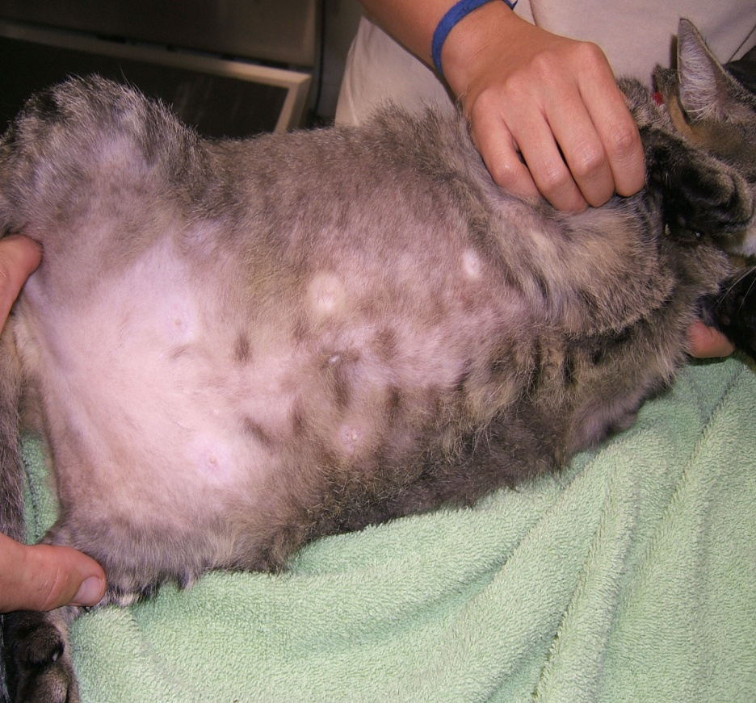
Herbs to Treat Hepatic Lipidosis
Shan Zha, Fructus Crataegi- -Alfalfa
Shi Jue Ming, Concha Haliotidis- -Clams
Ling Zhi, Fructificatio Ganodermae Lucidi- -Ginger

