Slide 1
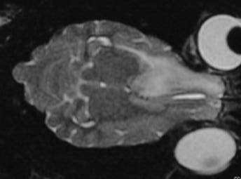
CNS Neoplasia
Today’s Frontier

Slide 2
CNS Neoplasia- -Dogs
Common Types
Meningioma
Astocytoma
Oligodendroglioma
Choroid plexus papilloma
Lymphoma
Neuroectodermal tumors
Metastatic tumor

Slide 3
CNS Neoplasia- -Dogs
Dog has 1-18 months average survival time
1-3 with nothing
6-9 with surgery
12-18 with radiation treatment
All tumors are invasive (malignant)

Slide 4
CNS Neoplasia- -Cats
Most common is meningioma
Usually extra-axial and benign
Seen in aged cats
Present with depression and dementia

Slide 5
Elvis

Slide 6
Elvis
MRI revealed mass in the cerebral cortex

Slide 7
Elvis

Slide 8
Treatment
Prednisolone (0.25-0.5 mg/kg q12h)
Treats secondary effects
Cover with gastroprotectants
Chemotherapy
Radiation therapy

Slide 9
Chemotherapy
Lomustine
60 mg/M² given
Monitor CBC weekly
If WBC and platelets okay in 5 weeks, then give 80 mg/M²
Repeat every 5-8 weeks
Procarbazine
2-4 mg/kg/day for 1 week, then 4-6 mg/kg/day
Monitor CBC
Continue as long as WBC levels are > 4000/µl & platelet count is > 100,000/µl

Slide 10
Chemotherapy
5-hydroxyurea
Meningiomas
50 mg/M² given
Monitor CBC weekly
Repeat every 3-4 weeks
Melatonin
Gliomas
0.1-0.2 mg/kg once a day in the evening
Reduces growth of many tumors by 50%

Slide 11
Treatment
Diet
Low carbohydrate
Supplements
Antioxidants & membrane stabilizers
Herbal medications
Western- -Canine Cancer formula
Traditional Chinese medicine- -Stasis in the Mansion of the Mind

Slide 12
Blood Stagnation
Hz:
Acute Seizures
Head Injury
Tongue
red & greasy
Pulse
Fast, wiry & slippery
Rx Principle
expel phlegm, extinguish the wind, open the orifice, stabilize the seizures and invigorate blood
AP
CV-15, ST-40, PC-5, HT-7, LI-11, LIV-3, An Shen, Da Feng Men
TCM Herbal
Ding Xian Wan
TCVM Cancer Treatment

Slide 13
Stasis in Mansion of Mind
Angelica Bai Zhi Warm the Channel, relieve pain
Pinellia Ban Xia Transform phlegm
Ligusticum Chuan Xiong Move Blood
Salvia Dan Shen Move Blood
Lumbricus Di Long Clear Wind, invigorate Channel
Ligusticum Gao Ben Relieve pain
Pueraria Ge Gen Bring Qi upward
Carthamus Hong Hua Break down Blood Stasis
Bombyx Jiang Can Transform phlegm, resolve nodule
Scorpion Quan Xie Break down Blood Stasis
Cimicifuga Sheng Ma Ascend Qi
Fritillary Zhe Bei Mu Transform phlegm, resolve nodules
Scolopendra Wu Gong Detoxify, resolve nodules

Slide 14
Max’s Formula
Bai Zhi Angelica Clear Wind-Cold and relieve pain
Da Huang Rheum Clear stagnation/stasis and clear Heat
Jie Geng Platycodon Open the Upper Jiao and transform phlegm
Mu Li(Shu) Ostrea Soften hardness and clear mass
Tian Hua Fen Trichosanthes Clear Heat and promote body fluids
Xia Ku Cao Prunella Clear Liver Heat and resolve nodules
Xuan Shen Scrophularia Clear Heat and cool Blood
Zhe Bei Mu Fritillaria Soften hardness and clear nodules

Slide 15
Wie Qi Booster
Bai Hua She She Cao Oldenlandia Inhibit cell mutation and tumor growth
Ban Zhi Lian Scutellaria Inhibit cell mutation, inhibit tumor growth
Chen Pi Citrus Move Qi and transform phlegm
Dang Gui Angelica Tonifies Blood
Dang Shen Codonopsis Tonify Qi and boost Wei Qi
Huang Qi Astragalus Tonifies Qi in whole body and Wei Qi
Wu Yao Lindera Move Qi and clear stagnation
Xuan Shen Scrophularia Cool Blood and nourish Yi

Slide 16
Stasis Breaker
Bai Hua She She Cao Oldenlandia Inhibit cell mutation and tumor growth
Ban Zhi Lian Scutellaria Clear Heat-toxin, inhibit cell mutation,
inhibit tumor growth
E Zhu Zedoaria Purge the interior, break Blood stasis and
clear mass
Mu Li(Shu) Ostrea Soften hardness and clear mass
San Leng Sparganium Purge the interior, break stasis and clear
mass
Zhe Bei Mu Fritillaria Soften harness and clear nodules

Slide 17
Reba
5 year old, German Shorthair Pointer
History of seizures starting 1 month prior
Responsive to phenobarbital
Tongue: purple
Pulse: fast & wiry

Slide 18
Reba
Neurologic Exam
Mild dementia
CP deficits in both hind legs
Babinski’s sign on left side of the body
Localization
Cerebrum affecting both side (>right)

Slide 19
Reba- -1st CT scan

Slide 20
Reba
Di Tan Tang
Stasis in Mansion of Mind
Wei Qi Booster
Western herbs

Slide 21
Jerry
10 year old, Mx
Progressive loss of coordination and head tilt
Personality change
Tongue: purple
Pulse: fast & wiry

Slide 22
Jerry
Neurologic Exam
Left head tilt
Positional, vertical nystagmus
Mild CP deficits in rear L>R
Xextensor R -> L in rear
Localization
L Cerebellar pontine angle with cerebral signs

Slide 23
Jerry
TCM Dx:
Liver Blood Stagnation
TCM Rx:
Stasis in Mansion of Mind
Wie Chi Booster

Slide 24
Jerry- -MRI scan

Slide 25
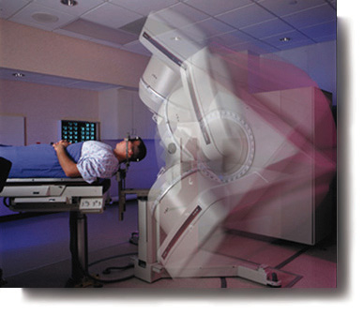
Radiosurgery (3D radiation therapy)
McKnight Brain Institute at UF
High, single dose radiotherapy
5 arcs of radiation provide sphere of death
Based upon the focal size and tissue treated

Slide 26
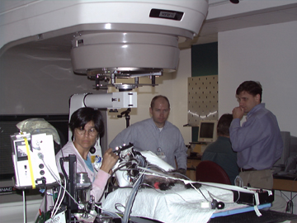
Radiosurgery- -Treatment
Treatment is applied with LINAC unit at UFBI
Cost of radiosurgery
procedure is around $3000.00
plus workup & conventional surgery

Slide 27
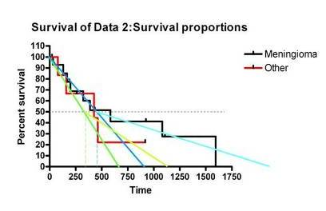
Radiosurgery Success
Overall ED50 is around 13 months
Some patients survive much longer
Prognosis for meningiomas is better than others

Slide 28
Cancer Recommendations
Low-Carbohydrate food (home prepared is best or use Pedigree Weight Loss Formula)
Canine basic antioxidant formula (Westlab Pharmacy 1-800-4WESTLA)
Canine arthritis formula (Westlab)
Canine cancer formula (Westlab)- -use at 2 times prevention dose
COX-2 inhibitor (daily- -particularly for carcinomas)
Melatonin at night (0.1-0.2 mg/kg)

Slide 29
TCVM Brain Cancer
Max Formula
Stasis in Mansion of Mind
Wei Qi Booster
Western herbs
or
Transports to Head
and
and

Slide 30
Wonderland

Slide 31
Thor
7 year old M/C Rottweiller
2 month history neck and back pain
Minimal response to carprofen

Slide 32
Thor

Slide 33
Thor
Localization of Lesion
D
A
M
N
N
I
I
I
T
T
V
IVDD (Wobblers)
C1-T2 (particularly C6-T2 exramedullary)
Spinal Tumor
Myelitis
GME
O

Slide 34
Thor
Problem List
Differential Dx
?
Diagnostic Approach
?
Treatment
?
IVDD
Infection
Inflammation
Neoplasia
Neck Pain
Back Pain
Foreleg Lameness
Posterior Paresis
P

Slide 35
Thor- -Diagnostic Approach
MDB
CBC
Chemistry Profile
UA
Chest & Abdominal Radiographs
Abdominal Ultrasound
Neurologic Tests
EMG
CSF Analysis
Cisternal
Lumbar
Myelogram ± CT scan
Client Education
P

Slide 36
Thor- -MDB
Unremarkable
O

Slide 37
Thor- -CT/Myelogram

Slide 38
Thor- -TL Myelogram

Slide 39
Thor- -TL CT

Slide 40
Thor- -Final Diagnosis
Caudal Cervical IVDD
Lumbar Neoplasia
A

Slide 41
Thor- -Client Education
Without aggressive surgery, chemotherapy or radiation therapy, the prognosis is poor
May continue to progress over 1-18 months
Treat for pain as needed
Consider CAVM & TCVM approaches to augment or instead of Western therapy
P

Slide 42
Thor- -TCVM exam
Tongue
Red/purple
Pulse
Weak bilaterally
Fast
Sensitivity
GB 21
BL 18
BL 23
TCVM Diagnosis
Combined Qi/Yin Deficiency with Blood Stagnation

Slide 43
Thor- -TCVM Therapy
AP
Cervical points
BL10
GB 21
Cervical Hua-tuo-jia-ji
Lumbar points
Bai Hui
BL40
BL62
Cancer points
TH 5
GV14
ST36
LIV3
Herbal
Max Formula
½ dose
Jing Tang
Stasis in Mansion of Mind Formula
full dose
Jing Tang
Hindquarter Formula
½ dose
Jing Tang

Slide 44
Cervical Neoplasia
Acute or chronic progressive quadriparesis
Usually has neck pain
Often in older animals

Slide 45
Cervical Neoplasia
Acute or chronic progressive quadriparesis
Usually has neck pain
Often in older animals

Slide 46
Cervical Neoplasia
Surgery with follow up fractionated radiotherapy

Slide 47
Spinal Cord- -Neoplasia
Neurofibrosarcoma

Slide 48
Rudy

Slide 49
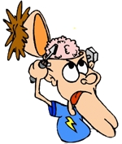
Rudy
Localization of Lesion
T3-L3 (close to T3)
O

Slide 50
Rudy- -MRI
R
R
O

