Slide 1
A Short History of Medicine
2000 B.C. Here, eat this root
1000 A.D. That root is heathen.
Here, say this prayer.
1850 A.D. That prayer is superstition.
Here, drink this potion.
1940 A.D. That potion is snake oil.
Here, swallow this pill.
1985 A.D. That pill is ineffective.
Here, take this antibiotic.
2000 A.D. That antibiotic is artificial.
Here, eat this root.

Slide 2
TCVM Pediatric Food Therapy
RM Clemmons, DVM, PhD , CVA, CVFT, ACVIM (Neurology)
rmc@dog2doc.com

Slide 3
“The body is the temple of life.
Energy is the force of life.
Spirit is the governor of life.
If one of them goes off balance, all three are damaged.”
Wen‐tzu Classic (first century B.C.)

Slide 4
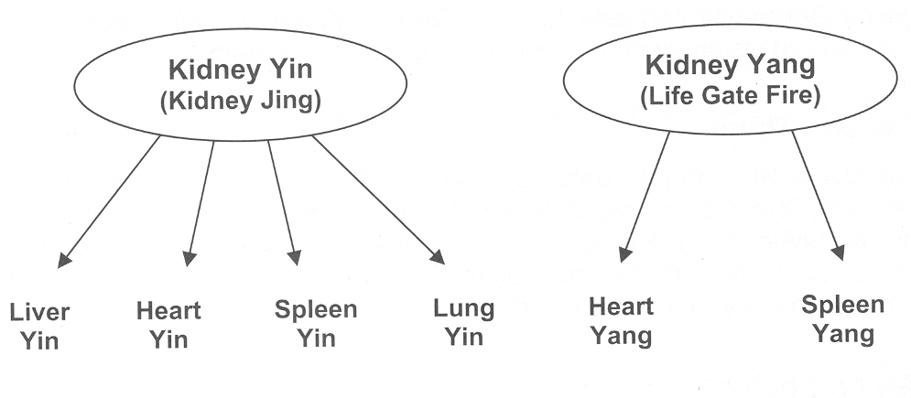
Kidney Essence Impowers
Kidney provides initial spark to all other organs
  During prenatal life of fetus
Timing & genetics dictate the resulting disease
  Which organ is affected

Slide 5
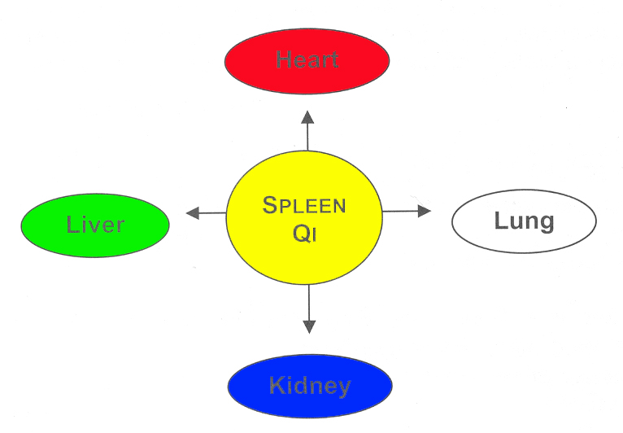
Spleen for Postnatal Essence
While kidney is central for prenatal life, Spleen is central for postnatal life
  Maintains vitality of other organs
  Helps protect and replentish prenatal essence

Slide 6


The Jing Candle
Candle bruning at both ends
  Original Kidney Jing
  Acquire Spleen Jing
Candles are different sizes based upon Kidney Jing
  Replenished slowly by spleen
JING
Gu Qi

Slide 7
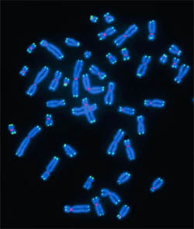
Telomeres
Highly repetitive region ofDNA at the end of a chromosome
DNA polymerase complex is incapable of replicating all the way to the end
  Pretects from loss of vital genetic information, which is needed for cell's activities
Every time a cell with linear chromosomes divides
  Lose a small piece of one of its strands of DNA.
  This process has been referred to by James Watson and Alexei Olovnikov as the "end replication problem" (1971)
Have a function in the ageing process.

Slide 8
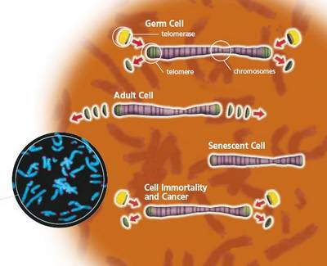
What does this mean?
Clones are inherently deficient
Adult stem cells are less robust
Artificial increase in telemeres leads to cancer
When the telemeres are gone, life ends

Slide 9
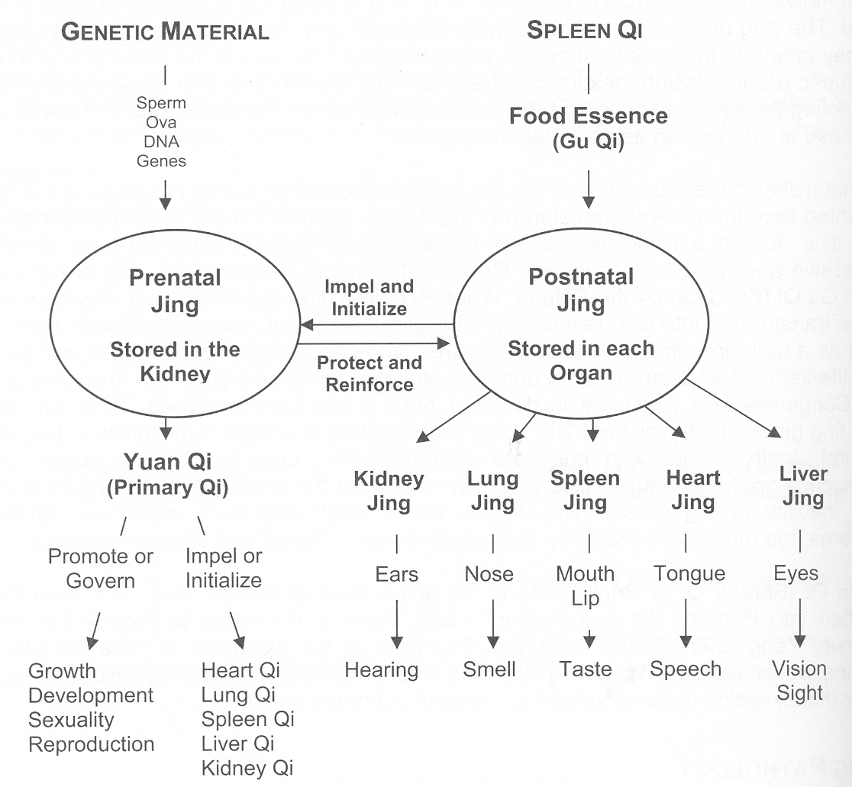
Life is Balance
Hope you get the best Jing
Protect it with diet
Live well and enjoy what you are given
Make lemonade

Slide 10
Yuan Qi
(Primary Qi, Source Qi, Original Qi)
  Derived from the Kidney Essence or congenital Essence
  It is Essence in the form of Qi, rather than fluid.
  Requires supplementation and nourishment by the Food Essence (Gu Qi)
  Comprises the Primary Yin (Kidney Yin) and the Primary Yang (Kidney Yang)
  It is the original dynamic motive force of normal activities.
  Distributed to the whole body by the Sanjiao
  Impels the Zang-Fu organs to bring normal activities into play
  Maintains normal growth and development of the body
  Pathology: Yuan Qi Deficiency results in decreased disease resistance

Slide 11
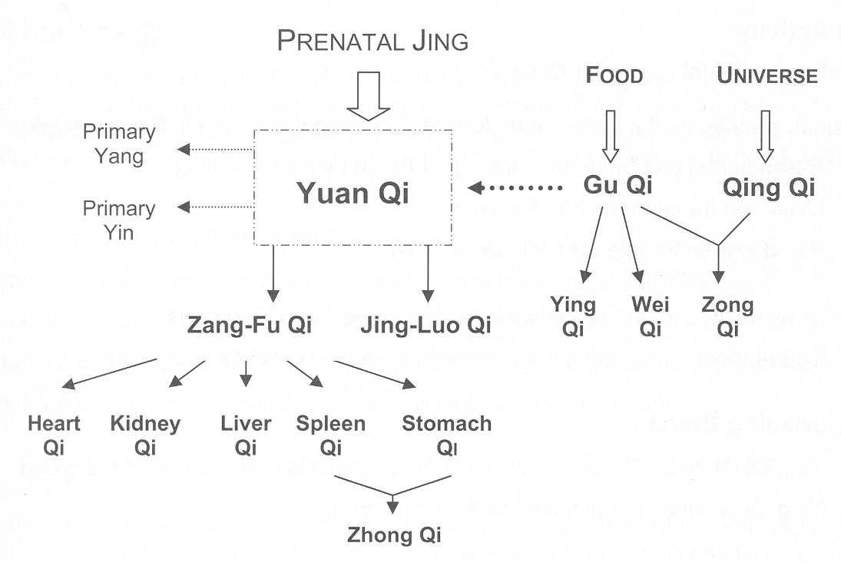
Energy of Life
Yuan Qi impels the function of the organs

Slide 12
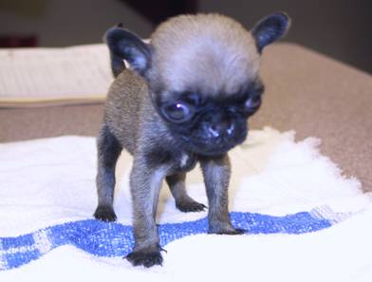
JING PATHOLOGY
Signs of Jing Deficiency
  Retarded or poor growth
  Developmental orthopedic diseases
  Loss of vitality
  Infertility
  Early aging

Slide 13
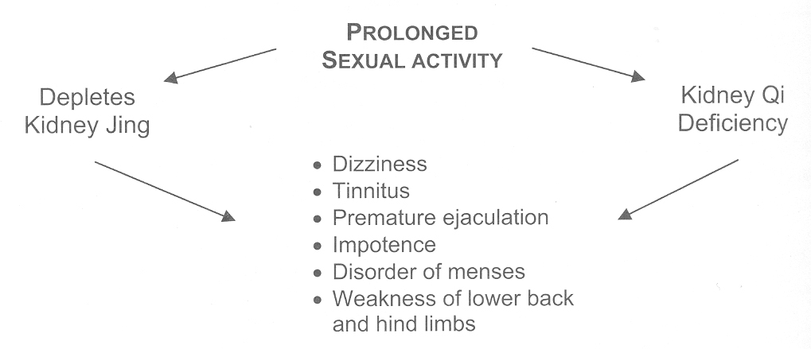
Jing Pathology
Can be acquired from too much strain on the candle
One of the problems of the Chinese emperors

Slide 14
Pathology of Kidney
Jing Deficiency (original or acquired)
LIV- -joint disease
Child
Fear or Stress or Pathogens
Kidney
LU/LI- -asthma & edema
HT/PC- -shen
Parent
Grandchild
Organ
KID- -nephritis
Grandparent
Channel
SP/ST- -damp
Bone, Marrow, Head
Ears
BL
Incontinence

Slide 15

CAM Use in Kids
1992-2005, 66 pediatric utilization studies US, Canada, UK, Australia, Turkey, Norway…
General and subspecialty populations
Use increasing
Complementary and Alternative Research and Education Program

Slide 16
Pediatric Epidemiology
Spiegelblatt ’94 Pediatrics ; 11% used prof. CAM
Ottolini, et al, W, DC, ‘98: 20% of kids in 4 practices
Taylor, et al, Seattle, ‘98: 30% -50% use echinacea or vitamin C for kids’ colds
Indiana teens ‘98: 20-30% of athletes take supplements
Crow, et al. Ped Res, ’03: 46% w/vitamins; 15% wo/vitamins in Chicago PPRG
Wilson, et al AmbPeds ’02: 53% of Rochester teens
Lin, et al J Clin Anesth ’04: 30% pediatric pre-op pts use herbs
Breuner APAM ‘98: 70% homeless teens

Slide 17
Children with other conditions
Autism: 30%;
Asthma: 72%-81% of minority (H and Af.A.) families;
Cancer: 47% of kids at WFUSM in 2003; 73% of kids in Washington state in 2001;
CF: 65%, mostly prayer
Cerebral palsy: 56% of 235 families in Ann Arbor
ED: 53% used herbs, Atlanta
IBD: 41% of kids in Boston, Detroit, London
Rheumatology: 64% of 141 in Toronto, 2003
Special needs: 24% for kids with correctable condition vs. 76% for kids with non-correctable condition

Slide 18
Which CAM therapies most commonly used?
Prayer – most common, least worrisome to MDs
Herbal therapies, vitamins, minerals and other dietary supplements – most worrisome to MDs
Chiropractic – most common professionally provided to adults; historical competitive threat
Massage – most common professionally provided to kids; often taught to parents or provided informally
Homeopathy – not well enumerated; confusion with herbs
Yoga, Tai Chi
Acupuncture/acupressure
Biofeedback, hypnosis

Slide 19
What are pediatricians most often asked about CAM?
Herbs, dietary supplements (67%)
Chiropractic (59%)
Nutrition and special diets, vegetarian, macrobiotic diets (46%)
Homeopathy (36%)
Therapeutic exercise, yoga (34%)
Hypnosis, biofeedback or meditation (23%)
Massage or other bodywork (17%) ….
Prayer (13%)
Kemper, O’Connor. Amb Peds, 2004

Slide 20
Only 40% tell docs about CAM
“Natural”, not medical; irrelevant , “not important for the doctor to know” 61%
Docs not interested; “the doctor never asked” 60%
“None of the doctor’s business” 31%
“Doctor would not understand” 20%
Cultural practice - embarrassing or private, <20%
Fear of physician reaction (disapproval, abandonment, worse medical care) < 15%
Eisenberg DM, et al. Arch Intern Med, 2001; 135: 344-51

Slide 21
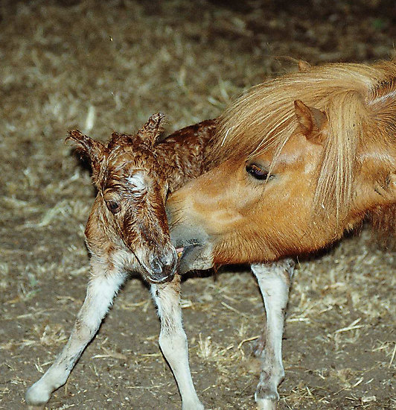
Pediatric AP
Abdominal Pain
Anorexia
Childhood Diarrhea
Cough
Otitis
Icterus Neonatorum
Convulsions
Paralysis

Slide 22
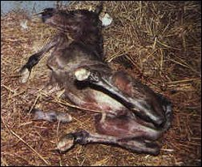
Pediatric Colic
Patterns
  Cold in the middle-jiao
  Retention of food
  Blood stagnation
  Yang deficiency

Slide 23
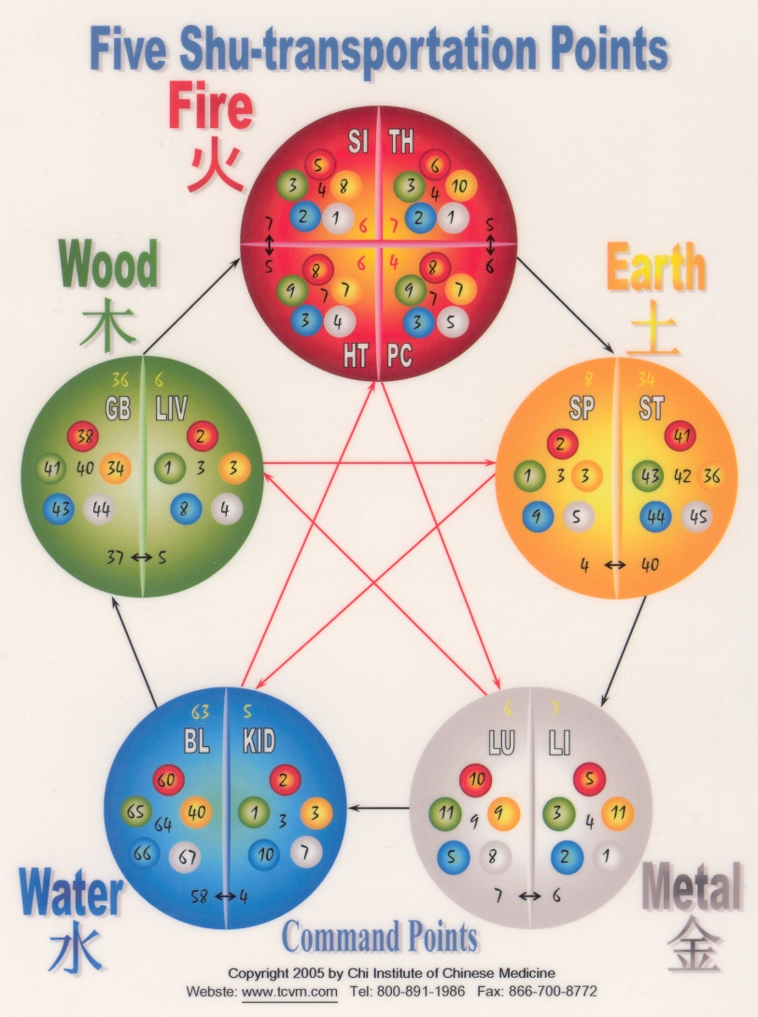
Consequences of Jing Deficiency
Leads to disease of organs
  Heart
  GI tact
  Lung
  Kidney
  Liver
Severe disease
  Early affects
Mild disease
  Later effect

Slide 24
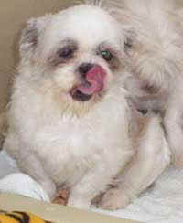
Chance
8 month M Lhasa apso
Seizures for 1 month
Tongue: red purple
Pulse: deep & weak
  Di Tan Tang and Epimedium Powder

Slide 25
Kidney Jing Deficiency
Kidney Jing Deficiency
Blood Deficiency
Kidney Yin Deficiency
Liver Yin Deficiency
Fails to Nourish Jin (sinews)
Internal Wind
Seizures

Slide 26
Kidney Jing Deficiency
Hz:
  Seizures < 1 year of age
  Dry nose & mouth
Tongue
  Pale or red
Pulse
  Weak & thready
Rx Principle
    extinguish the wind and astringe or nourish the kidney jing
AP
  KID-3, BL-23, SP-6, GV-20, ST-36, HT-7, GB-20, An Shen, Da Feng Men
TCM Herbal
  Di Tan Tang and Epimedium Powder

Slide 27
Epimedium Powder
Epimedium Yin Yang Huo Tonify Kid Yang/Jing, Promote Sexual Desire
Cuscuta Tu Si Zi Tonify Kid Yang, Jing & Yin
Cistache Rou Cong Rong Tonify Kid Yang & Yin
Paeonia Bai Shao Yao Nourish Liver Yin & Blood
Polygonum He Shou Wu Nourish Blood & Jing, Benefit Hair
Actinolite Yang Qi Shi Tonify Kid Yang
Cynomorium Suo Yang Tonify Kid Yang
Psoralea Bu Gu Zhi Tonify Kid Yang & Strengthen Bones
Dipsacus Xu Duan Tonify Kid Yang & Promote Fracture Healing
Lycium Gou Qi Zi Nourish Liver Yin, Benefit Eyes
Condonopsis Dang Shen Tonify Qi
Astragalus Huang Qi Tonify Qi
Rehmannia Shu Di Huang Nourish Kid Yin & Jing
Angelica Dang Gui Nourish Blood
Ophiopogon Mai Men Dong Moisten & Nourish Yin
Scrophularia Xuan Shen Cool Blood & Clear Heat
Citrus Chen Pi Move Qi & Relieve Pain

Slide 28
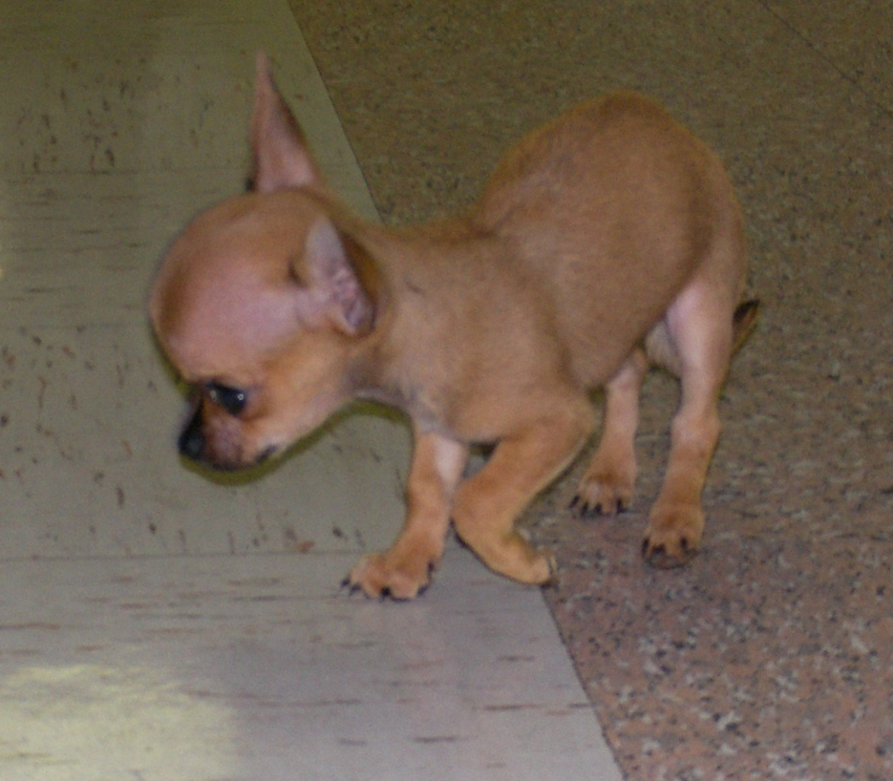
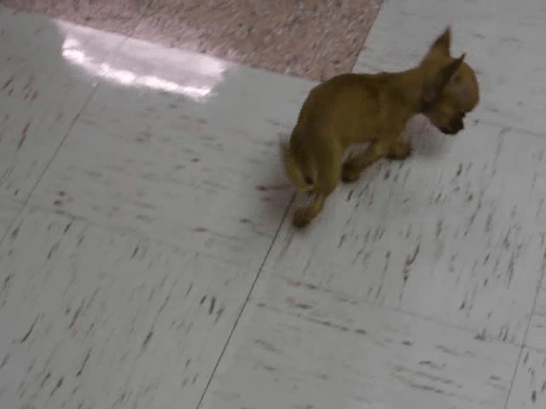
Jocko

Slide 29
Jocko
Problem List
  Shen Disturbance
  Hydrocephalus
    Confirmed ultrasound
  Hepatoencephalopathy
    Confirmed BW
  Overall poor development
TCVM
  Tongue
    thin-red
  Pulses
    Deep, weak fast particularly on right side
Diagnosis
  Jing Deficiency
  Yin deficient
Treatment
  Hydrocephalus formula
  Liu Wei Di Huang
  Epimedium powder

Slide 30
Food Energetics‐ Xing
Thermal energetic properties of food
  Refers to the effect of food on the digestive, metabolic, and physiologic functions of the body
The “Temperature” of food Even the flavor imparts Xing
  Rostral‐ primary
  Caudal‐ secondary

Slide 31
Food Energetics‐ Xing
How food is prepared: cooked, or not, alters Xing
  Raw food is cooler than cooked
The more processing a food undergoes, the warmer it becomes
  Fine cutting, grinding, pounding, pressing all release more heat and energy from foods
  Whole grain foods are cooler than their fractioned, ground or refined counterparts
  Whole muscle is cooler than ground meat
Cannot change overall Xing by just preparation
  Ex: Lamb will never be cool no matter how you processes it or prepare it

Slide 32
Food Energetics‐ Xing
Foods with higher water content are cooler than dense foods
Faster growing foods (lettuce) are cooler than their slow‐ growing, dirt‐ filled counterpart (potato)
Dried foods are warmer than fresh foods The flavor of one food combined with growing nature of another can yield a balanced neutral effect
Know your patients
  books, agriculture, soil can change
How do you feel when your done eating?

Slide 33
Food Energetics‐ Xing
Flavor‐ taste of food in the mouth, on the tongue
  Rostral tongue‐ primary
  Caudal tongue‐ secondary
Sour‐ Wood‐ LIV/ GB
  Astringent or holding/ gathering quality
Bitter‐ Fire‐ HT/PC/ SI/ TH
  Draining, counterbalance dampness quality
Sweet‐ Earth‐ SP/ ST
  Tonifying and moistening quality
  Good for pediatrics as they usually have a weak Spleen
Pungent‐ Metal‐ LU/ LI
  Dispersing quality, promotes flow
Salty‐ Water‐ KID/ BL
  Softening and detoxifying quality

Slide 34
Food Energetics‐ Preparation
Process | Effect
Raw | Cool
Sreamed/Poached | Cool/Neutral
Boiled | Neutral
Stewed | Warm
Stir-fried | Warm
Baked | Warm
Deep-fried | Hot
Roasted | Hot
Grilled | Hot
BBQ | Hot

Slide 35
Food Energetics
The time at which an animal is killed for processing
  Young‐ warmer….ex: chicken
  Older‐ cooler……..ex: turkey
The diet of an animal
    Grain fed cattle are warmer than free‐ range
  Wild rabbit‐ cooler than farm‐raised
  Antibiotics, growth hormones and other stimulants commonly used non‐organic agriculture increases the thermal nature; including fish Ex: Salmon, Tuna

Slide 36
Requirements for Puppies
Need more calories than adults
Need more DHA for brain and eye development
Need vitamin E and selenium as antioxidants for immune support
Need optimal Calcium to Phosphorus ratio (1.2:1 -- 1.4:1)

Slide 37
TCVM‐ Kittens
Kittens Need Jing and Yang Tonics to augment growth
  Not too rich or too warm
Jing and Yang Tonics:
  Abalone, egg, duck, rabbit, bone marrow, sardine, tofu, barley, oats, quinoa, millet, squash, parsley, walnut
Don’t forget probiotics and digestive enzymes

Slide 38
Supporting Jing
Purebred puppies are usually Jing deficient
Jing and Blood Tonics
  Raw marrow bones, beef rib bones, tendons, ligament cartilage, hooves, small amounts of organ meats (organic liver only), chicken wings, chicken necks
  room temp, not cold or it will further damage SP
  can blanch or boil for 1 min

Slide 39
Herbal Food Therapy
Jing Deficiency
Epimedium Powder
  Epimedium‐ Yin Yang Huo: sweet, dry, tonifies liver/ kidney, sinks liver Yang
    (mackerel, barley, kidney bean, turnip)
  Cuscuta‐ Tu Si Zi: pungent, neutral, liver/ kidney
    (Abalone, corn, orange, mushroom)
  Cicstache‐ Rou Cong Rong: sweet, salty, warm, KID/ LI
    (Anchovy, tapioca, parsley)
  Paeonia‐ Bai Shao Yao: bitter, sour, cool, liver, spleen
    (Chicken egg, chrysanthemum, vinegar, eggplant)

Slide 40
KID Jing Diet
Focus: Nourish essence, tonify Kidney Qi, Yin and Yang, tonify Spleen
  You can NEVER have too much Jing
Energetics: sweet, warm with global Qi tonics
Meat/Dairy: beef/lamb/pork kidney, chicken, abalone, mussel, oyster, bone, marrow (+ spinal cord/ brain), eggs, raw milk
Grains/ Legumes: quinoa, millet, spelt, wheat, black beans, kidney bean, black soy bean
Vegetable/Fruit: Microalgae (chorella, spirulina, blue- green algae), barley/wheat grass, beet, seaweed, reishi, mulberry, date, fig, raspberry, wolf berry, lycium berry
Nuts/Seeds: almond, black sesame, chestnut walnut
Other: royal jelly, bee pollen, aniseed, cinnamon bark, fennel seed, arnica flower, nettle, chickweed, vitamin-A, vitamin-D, zinc

Slide 41
Basic Antioxidants
Dogs
Cats
Vitamin E 10 IU/lb daily
Vitamin C 5-10 mg/lb twice a day
Selenium 2 µg/lb daily
Beta carotene 250 IU/lb daily
B Complex 2mg/kg twice a day
Vitamin E 100-400 IU daily
Vitamin C 100-250 mg twice a day
Selenium 50 µg daily
Vitamin A 1000-5000 IU daily
B Complex 10 mg twice a day

