Slide 1
TCVM Heart Food Therapy
Heart Physiology
Heart Pathology
Cases (CHF)

Slide 2
Fire
Sound
  laugh
Emotion
  joy
Climate
  heat
Season
  summer
Direction
  south
Opening
  tongue
Body Part
  tongue
Zang/Fu
  HT/SI - PC/TH

Slide 3
TCM HEART Physiology
Dominates the Blood & Vessels
Houses the Mind
Controls Sweating
Opens in the Tongue

Slide 4
TCM HEART Physiology
Dominates the Blood & Vessels
  Motive force behind blood circulation
  Requires proper Heart Qi function for normal pulse and mucous membrane color
  Deficiency leads to weak, thready pulse and pale tongue

Slide 5
TCM HEART Physiology
Close relationship between the Heart, the Blood and the Vessels
  Changes in Heart Blood or Qi will affect pulse rate, quality, mucus membrane color
  Heart itself
Strong Heart Qi and Ample Blood
  Pulse will be regular and strong and pink color tongue
  Strong Heart with strong constitution and empowerment
Weak Heart Qi or Blood (trauma, blood stagnation, emotional fatigue)
  Yields weak, thready pulses and pale tongue color
  Weak heart with a weak constitution including shen disturbance (mental problems, fatigue)

Slide 6
TCM HEART Physiology
Houses the Mind
  Mental activity, memory, sleep
  Primarily related to Heart Blood
  Deficiency of Heart Blood leads to restlessness, anxiety and shen disturbance
    Blood is the foundational substance for mental activity/acuity and is the root of the mind

Slide 7
TCM HEART Physiology
Controls Sweating
  Blood carries body fluid and is interchangeable with it
  Body fluid is used to make up sweat
  Heart deficiency leads to spontaneous sweating
    Night- -Yin
    Day- -Yang

Slide 8
TCM HEART Physiology
Opens in the Tongue
  Controls color and appearance of the tongue, particularly tip
  Deficiency in Heart Blood shows pale (dry) tongue
  Excess heat in Heart causes dark red tongue

Slide 9
TCM Pericardium Physiology
Protects the Heart
In Practice, considered the same as the Heart
Treat the same
May be more related to shen

Slide 10
TCM 24 Hour Clock

Slide 11
Fire
BALANCED
DEFICIENT
EXCESS

Slide 12
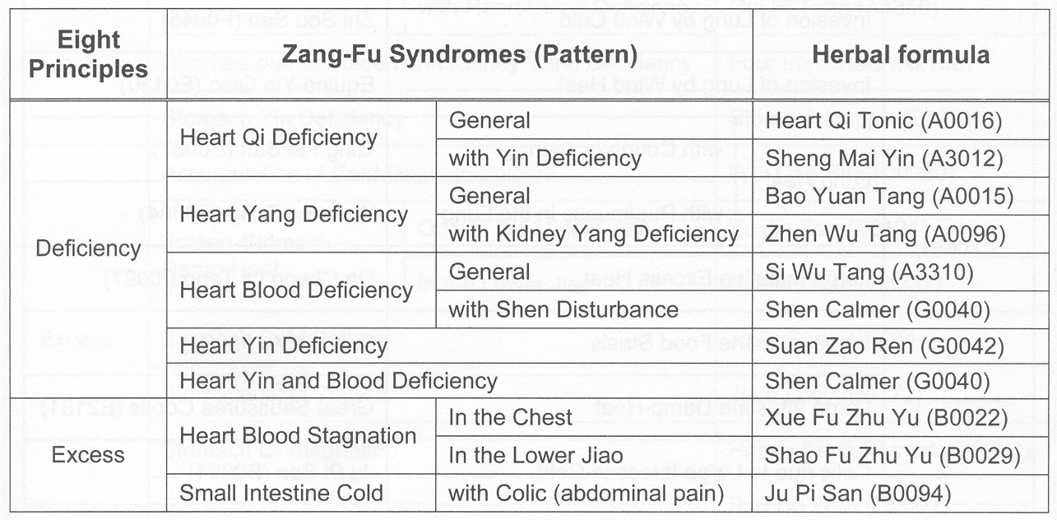
Heart Pathology

Slide 13
8 Principle HT Disharmonies
Excess
Heart Heat
Phlegm Fire/Phlegm Heat disturbing the mind
Phlegm obstruction misting the mind
Heart Blood Stagnation

Slide 14
8 Principle HT Disharmonies
Deficiency
Heart Qi Deficiency→DCM, CHF
Heart Yang Deficiency→Arrhythmia, AV blocks
Heart Yin Deficiency→HCM
Heart Blood Deficiency→Anemia, Fear, Anxiety
*When the heart is challenged, the problem is usually severe, difficult to treat, requires extensive treatments, affects other organs

Slide 15
Congestive Heart Failure
Heart Qi Deficiency | Shortness of breath Palpitations Spontaneous sweating Listlessness Pale tongue Weak, irregular pulse | Heart Qi tonic
Heart Yang Deficiency | Shortness of breath Palpitations Spontaneous sweating Listlessness Lassitude Fatigue Lethargy Loose Stool Cool ears & nose Pale-purple tongue Weak irregular pulse | Bao Yuan Tan
Kidney Yang Deficiency | Cough Shortness of Breath Ascites Edeam in rear limbs Warm seeking Cold back and limbs Pale-purple tongue Deep, weak pulses | Zhen Wu Tang

Slide 16

Buster Brown
History
  Not doing well
  Exercise intolerance
  Restlessness
TCVM Exam
  Pulses weak and irregular
  Pale, wet tongue
  Sensitivity BL15
DX: Heart Qi Deficiency

Slide 17
Buster Brown Treatment
AP:
  DN
    BL15, CV17, ST36, HT7, PC6
  Aqua
    BL15, HT7
Herbal
  Heart Qi Tonic

Slide 18
Heart Qi Tonic
Condonopsis | Dang Shen | Tonify Qi
Astragalus | Huang Qi | Tonify Qi
Licorice | Can Cao | Tonify Qi
Poria | Fu Ling | Drain Damp & Strengthen Spleen
Ligusticum | Chuan Xiong | Move Blood
Angelica | Dang Gui | Nourish Blood
Biota | Bai Zi Ren | Tonify Heart
Polygala | Yuan Zi | Tonify Heart
Schisandra | Wu Wei Zi | Astringe & Consolidate
Cinnamon | Rou Gui | Warm Yang

Slide 19
Heart Qi Deficiency Food
Heart Qi Tonic Herbs
  Condonopsis (Dan Shen)- Qi Tonic
  Astragalus (Huang Qi)-Qi Tonic
  Licorice (Gan Cao)- Harmonizing
  Poria (Fu Ling)- Drain Damp
Diet: Add raw herbs to home cooked diet…or
  Qi Tonic: Beef, tripe, chicken, liver, goose, ham, garbanzo bean, soybean, shiitake, corn, oats, rye, carrot, pumpkin, fennel
  Drain Damp: Quail, barley, coix, basil, fresh ginger

Slide 20
Heart Qi Deficiency Food
Wu Pi Yin
  Areca (Da Fu Pi)- Drains damp, promotes urination
  Citrus (Chen Pi)- Moves Qi
  Ginger (Gan Jiang Pi)- Qi Tonic, regulates water
  Poria (Fu Ling)- Promotes urination
Diet:
  Drain damp: : anchovy, sardine, quail, barley, coix, basil, fresh ginger, horseradish, aloe, celery
  Calm the mind: exercise, lavender, chamomile

Slide 21
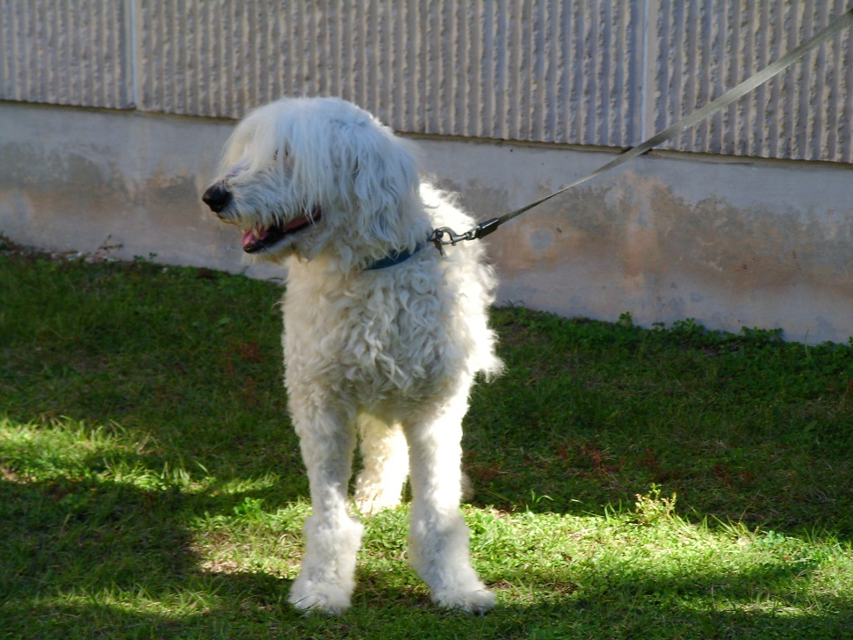
Barnaby
History
  Shortness of breath & decrease exercise tolerance
  Loose stools
  Rear leg weakness
TCVM Exam
  Pale-purple, swollen tongue with teeth marks
  Pulse weak & irregular
DX: Heart Yang Deficiency

Slide 22
Barnaby Treatment
AP
  DN
    HT7, BL15, CV17, GV4, Bai hui, Caudal Shen Shu, BL23, KID3, BL21
  Aqua
    GV4, BL15, BL21, BL23, Caudal Shen Shu
Herbal
  Bao Yuan Tang

Slide 23
Bao Yuan Tang
Astragalus | Huang Qi | Tonify Qi
Ginseng | Ren Shen | Tonify Qi
Cinnamon | Rou Gui | Tonify Yang
Licorice | Gan Cao | Harmonize

Slide 24
Heart Yang Deficiency Food
Tonify HT Qi, Warm HT Yang, Calm the mind
  Bao Yuan Tang
    Astragalus (Huang Qi)- Qi Tonic
    Ginseng (Ren Shen)- Qi Tonic
    Cinnamon (Rou Gui)- Tonify Yang
    Licorice (Gan Cao)- Harmonize
Diet:
  Yang Tonic: anchovy, goat, lamb, shrimp, venison, quinoa, buckwheat, walnut, pistachio, chestnut, clove, basil, garlic, cayenne, ginger

Slide 25
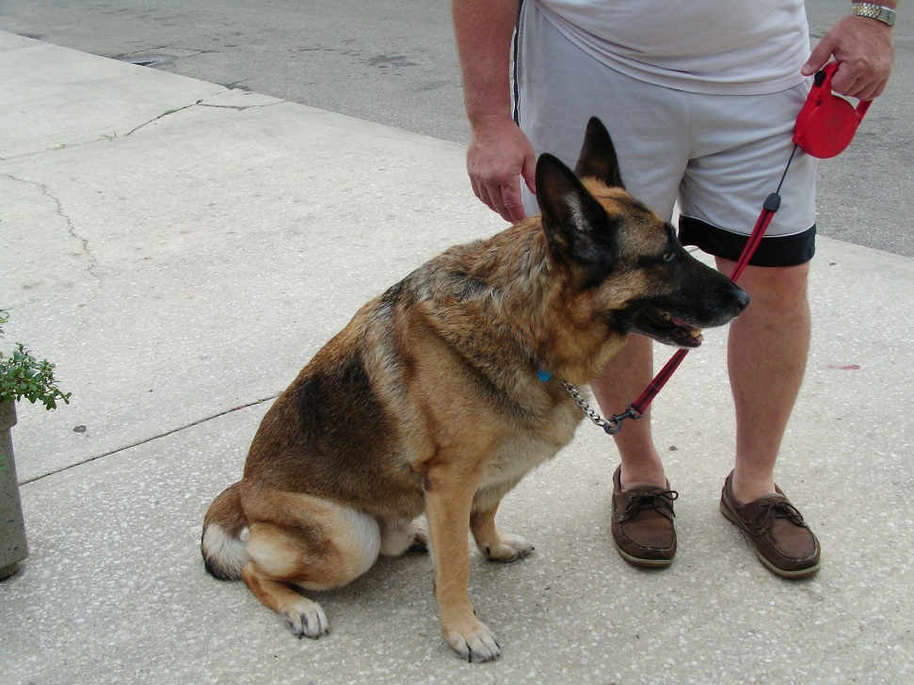
Rex
History
  Warm seeking
  Cool back and legs
  Mild pitting edema
  Occasional cough in morning
TCVM Exam
  Weak rear and sensitive at BL15 & BL23
  Deep, weak pulse
  Pale wet tongue (slight purple)
DX: Heart & Kidney Yang Deficiency

Slide 26
Rex Treatment
AP
  DN
    HT7, BL15, CV17, GV4, Bai hui, Caudal Shen Shu, BL23, KID3
  Aqua
    GV4, BL15, BL23, Caudal Shen Shu
  Moxa
    Bai hui, GV4, ST36
Herbal
  Zhen Wu Tang

Slide 27
Zhen Wu Tang
Aconite | Fu Zi | Warm the Interior and Tonify Kidney Yang
Zingiberis | Gan Jiang | Warm and Tonify Yang
Cinnamomum | Gui Zhi | Warm and Tonify Yang
Paeonia | Bai Shao Yao | Nourish Blood and Liver Yin
Atractylodes | Bai Zhu | Tonify Spleen Qi
Poria | Fu Ling | Drain Damp and Strengthen Spleen
Alisma | Alisma | Drain Damp
Polyporous | Zhu Ling | Drain Damp

Slide 28
Diet: (Tonify Qi, Support Yang, Calm the mind)
Flavor:
  bitter-warm, bitter-hot (small amts of hot),
  sour warm/hot,
  sweet warm/hot,
  acrid warm/hot
Meat: anchovy, goat, lamb, shrimp, venison
Grain: quinoa, buckwheat, oats, short grain rice (glutinous)
Nuts: pistachio, chestnut, clove Spice: basil, garlic, cayenne, ginger
Avoid: cold, bitter-cold, yogurt

Slide 29
HT Yin Deficiency
Nourish Yin, Clear Heat, Calm Shen, Nourish Kidney as this is the root source of Yin & Yang
Suan Zao Ren
  Zizyphus (Suan Zao Ren)- nourish Liver Blood & Heart Yin
  Ligusticum (Chuan Xiong)-move Qi/Blood & soothe Liver
  Anemarrhena (Zhi Mu)- Yin Tonic
  Poria (Fu Ling)- calm Shen, Strengthen Spleen
  Licorice (Gan Cao)- harmonize
Diet:
  Energetic: neutral (sweet, bitter, sour), cooling (sweet or sour)
  Meat: clam, cuttlefish, duck, frog, oyster, pork, tofu
  Grain: sweet potato, wheat, coix, oats, rice
  Vegetable/Legume: asparagus, endive, spinach, mung bean, kidney bean
  Fruit: apple, avocado, mulberry, pear, pineapple, tomato
  Avoid: overeating, hot, over bitter

Slide 30
HT Blood Deficiency Food
Diet:
  Energetic: Neutral, Warm and Cool, Sweet- Warm
  Meat: beef, bone marrow, eggs, liver, heart, sardines
  Grain: barley, corn, oats, wheat
  Vegetables/Legumes: adzuki bean, beet, carrot, kelp, dark greens
  Fruit: cherry, date, fig Avoid: hot, very bitter

Slide 31
Phlegm Misting the Mind
Zhen Xin San
  Codonopsis (Dang Shen)- Tonify Qi, calm Shen
  Ledebouriella (Fang Feng)- Eliminate Wind and Wind-Cold
  Poria (Fu Ling)- Drain Damp, calm Shen
  Coptis (Huang Lian)- Clear Heart Heat, detoxify
Diet: Eliminate Heart Fire, transform Phlegm, Calm Shen, Open Orifice
  Energetics: cool, bitter-cool/cold, sour- cool/cold
  Meat: avoid too much, grass fed beef, rabbit, turkey, deep ocean fish
  Grain: barley, brown rice, sweet potato, coix
  Vegetable/Legume: sprouts, cabbage, celery, bok choy, mushroom
  Fruit: watermelon, wintermelon, citrus, tomato
  Avoid: hot, damp, greasy, fatty foods

Slide 32
Additional Considerations
Diets should
  Consider salt content
    Na cause fluid retention
    K & Mg may be lost from diuretics
    Use KCl as salt
    Use Kelp (high in Mg, K & minerals)
  Balance with Calcium for 1.2:1 or 1.4:1
  Consider Hawthorne berry extracts
    Appetite stimulant
    Cardiotonic

