Slide 1
TCVM Food Therapy for Gastrointestinal Disorders

Slide 2
Introduction
TCVM Cooking Pot analogy of gastrointestinal function
  Used to emphasize Warm Transformation
  Cold Damage
  Moisture and Dampness

Slide 3
Cooking Pot and Science
Western Biomedicine and Digestion
  Mechanical and Biochemical
Biochemical Digestion
  Based upon Enzyme (Protein) Function
  Enzymes have Temperature Specificity
  Cold Temperatures interfere with Function
Cold Foods thus need to be Warmed by the Body

Slide 4
Cooking Pot and Science
Biochemical Digestion
  Enzymes have Temperature Specificity
  Cold Temperatures interfere with Function
Cold Food is Poorly Enzymatically Transformed
  Lower rate of digestion and absorption
Cold Food Challenges the Body to Warm it
  Challenge to all, especially Geriatrics
  Eventually depletes the body’s Yang Qi

Slide 5
Cooking Pot
Species specificity
  Damp-engendering foods for one may be adequate for another
Age and vigor
  Middle burner has more Yang Qi in younger animals than older so both environmental temperature and Xing of foods should be warmer in geriatric animals

Slide 6
Introduction to Food Therapy
Food therapy in Traditional Chinese Veterinary Medicine (TCVM) is based upon two fundamental principles
The first principle is of Food Energetics
  This refers to the effect of a food on digestive, metabolic, and physiological processes of the body
  Xing or Thermal Nature is essentially the post-ingestive effect on the body
Notes:
How do you feel seconds to hours after you eat it?

Slide 7
Food and Herb Properties
Xing or Thermal Nature or Temperature
  Cold such as Seaweed
  Cool such as Rabbit
  Neutral such as Rice
  Warm such as Chicken
  Hot such as Lamb

Slide 8
Food and Herb Properties
Flavor
  Sweet benefits SP/ST and strengthens, moistens and tonifies deficiency
  Pungent benefits LU/LI and disperses stagnation and promotes flow
  Salty benefits KI/BL and moistens, softens and detoxifies
  Sour benefits LIV/GB and stimulates absorption and contraction
  Bitter benefits HT/SI and drains and counteracts Dampness
  Bland is the 6th Flavor that drains dampness

Slide 9
TCVM Food Therapy: A Note on the Sweet Flavor
“Sweet” enters the Spleen and Stomach and engenders Qi and Blood
TCVM “Sweet” is a property of many foods
  This should be obvious since we eat to make Qi and Blood
But modern “Sweet” is an historical anomaly of refinement and excess availability of simple carbohydrates

Slide 10
TCVM Food Therapy: A Note on the Sweet Flavor
Modern “Sweet” is an historical anomaly of refinement and excess availability of simple carbohydrates
  In fruits this is called “empty sweet”
Natural sweet or “full sweet” is found in almost all whole grains, all nuts and seeds, most vegetables, and almost all fish and meats

Slide 11
Basic Food Properties: Introduction
Deficiency conditions are treated heteropathically with tonifying foods
Tonifying foods strengthen a bodily substance or function and are especially useful for chronic disharmonies
  Qi tonics
  Blood tonics
  Yin Tonics
  Yang tonics

Slide 12
Basic Food Properties: Qi Tonics
Qi tonics maintain and improve the quantity and quality of available energy in the body
Palatable Qi Tonifying foods for carnivores include
  Beef, Chicken, Date, Fig, Lentil, Mackerel, Microalgae, Molasses, Oats, Sweet Potato, Pumpkin and Squash

Slide 13
Advanced Food Properties: Introduction to Regulation
Whereas Tonifying foods strengthen a bodily function or substance Regulating Foods help remove Excess conditions or Stagnation
  Qi Circulating
  Blood Circulating
  Cooling foods
  Warming foods
  Foods which counteract Dampness
  Water-draining foods
  Phlegm-resolving foods

Slide 14
Advanced Food Properties: Qi Circulation
Qi Circulation is stimulated by the sweet and pungent flavors
Palatable Qi Circulating foods for carnivores include:
  Basil, Cardamom, Carrot, Cayenne, Clove, Coriander, Garlic, Hawthorn Berry and Turmeric

Slide 15
Advanced Food Properties: Damp
Dampness is a result of poor transformation and/or transportation of fluids
  Dampness is treated by avoiding dampening foods (e.g. dairy products, pork and rich meat, concentrated juices, sugar and saturated fats), by strengthening the Spleen and Stomach and by using bitter foods
Foods which counteract Dampness which are palatable to carnivores include:
  Alfalfa, Barley, Garlic, Green Tea, Job’s tears, Kidney Bean, Mackerel, Mushroom, Parsley, Pumpkin, Rutabaga, Rye and Turnip

Slide 16
Bian Zheng or Pattern Differentiation
Second Principle
TCVM is based upon Pattern Differentiation
Diagnostic systems include
  Yin/Yang
  Eight Principles
  Zang-Fu Organs
  Four Levels
  Six Stages
  San Jiao
  Pathogenic Factors

Slide 17
Bian Zheng or Pattern Differentiation: Basic
Treatment is based upon the inverse of Pattern of Disharmony (Heteropathy)
Not sure of Herbal Formula?
  Use cardinal signs to choose Food Therapy
For example, a dog with loose stools, weakness, shortness of breath, pale moist tongue and a weak pulse might be diagnosed as Spleen Qi Deficient
  The treatment principle is then to Tonify (Deficient) Spleen Qi

Slide 18
Bian Zheng or Pattern Differentiation: Basic
For the Spleen Qi deficient dog the weakness, pale tongue and the weak pulse suggest Deficiency
Use Tonifying foods such as Chicken, Oats, Quinoa, Yam and many of the culinary herbs to either add to the current diet or create a Food Therapy Formula for this dog

Slide 19
Bian Zheng or Pattern Differentiation: Advanced
Treatment is based upon the inverse of Pattern of Disharmony (Heteropathy)
  A diagnosis of Spleen Qi Deficiency?
  Treated by Tonifying (Deficient) Spleen Qi
Classical Herbal Formulae
  Already designed to treat Patterns
“Elegant” Food Therapy
  May formulate based upon detailed analysis of classical Herbal Formula

Slide 20
Spleen Qi Deficiency: Introduction
General signs of Qi Deficiency include lethargy and fatigue
Qi Deficiency signs are exacerbated by activity and improved with rest
Primary signs of Spleen Qi Deficiency include
  Loose stools
  Fatigue
  Shortness of breath
  Reduced appetite
  Pale moist tongue
  Weak pulse

Slide 21
Bian Zheng and Herbal Formula
Spleen Qi Deficiency
  Tonify Spleen Qi with the herbal formula Si Jun Zi Tang or Four Gentlemen Decoction
    the chief herb Panax ginseng ren shen is sweet, warm and tonifies Spleen Qi
    the deputy herb Atractylodis macrocephalae bai zhu is bitter, warm and strengthens Spleen Qi and dries Dampness
    the assistant herb Poria cocos fu ling is sweet, bland and leeches out Dampness and mildly Tonifies Spleen Qi
    the envoy Glycyrrhizae uralensis gan cao is warm, sweet and warms and regulates the middle burner

Slide 22
Si Jun Zi Tang and Food Therapy
A Food Combination that would have similar actions to Si Jun Zi Tang could include
  Warm, sweet Chicken which enters the Spleen and Stomach to Tonify Qi
  Warm, sweet Oats to strengthen the Spleen and dry Dampness
  Or neutral, bitter Rye to drain Dampness and Water from the Spleen

Slide 23
Si Jun Zi Tang and Food Therapy
A Food Combination that would have similar actions to Si Jun Zi Tang
  Cool, sweet Mushroom to leech Dampness and mildly tonify Spleen Qi
  Neutral, sweet and sour Coriander to direct the actions to the middle burner and mildly warm the Spleen and Stomach
  Use acrid, warm, aromatic Cardamom (Sha Ren) if there is also Phlegm or vomiting

Slide 24
Si Jun Zi Tang Food
How?
  Identify food substitute
  Calculate contribution needed
  Develop diet
  Check for balance
  Add essential vitamins, minerals, fatty acids and amino acids.

Slide 25
Si Jun Zi Tang Food
Panax ginseng (ren shen) Chicken
Atractylodis macrocephalae (bai zhu) Oats/Rye
Poria cocos (fu ling) Mushrooms
Glycyrrhizae uralensis (gan cao) Coriander/Cardamom

Slide 26
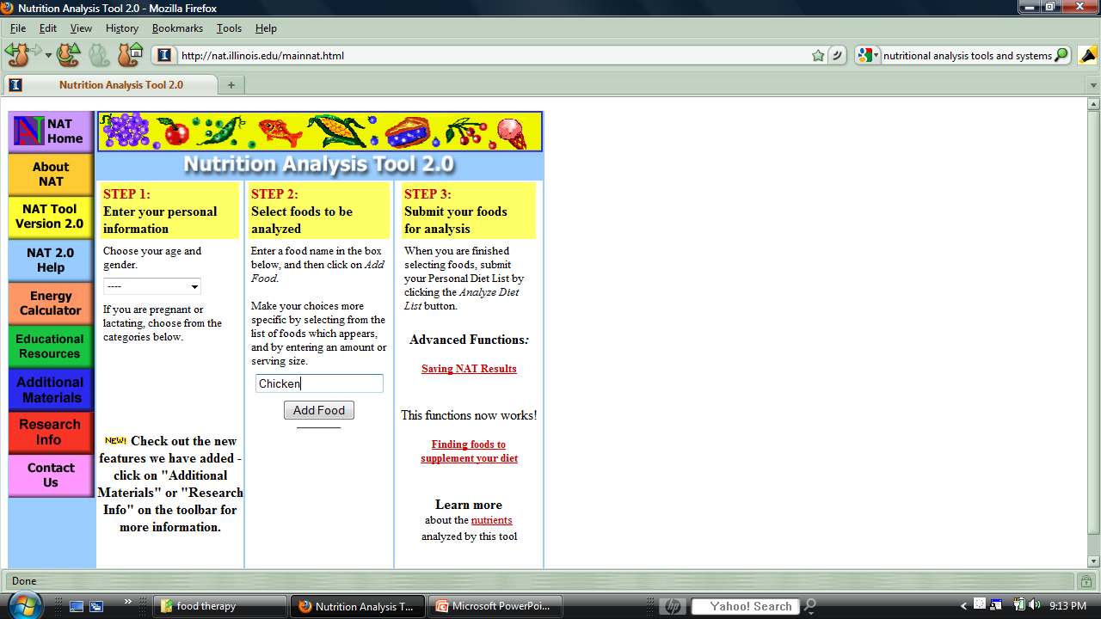
Si Jun Zi Tang Food

Slide 27
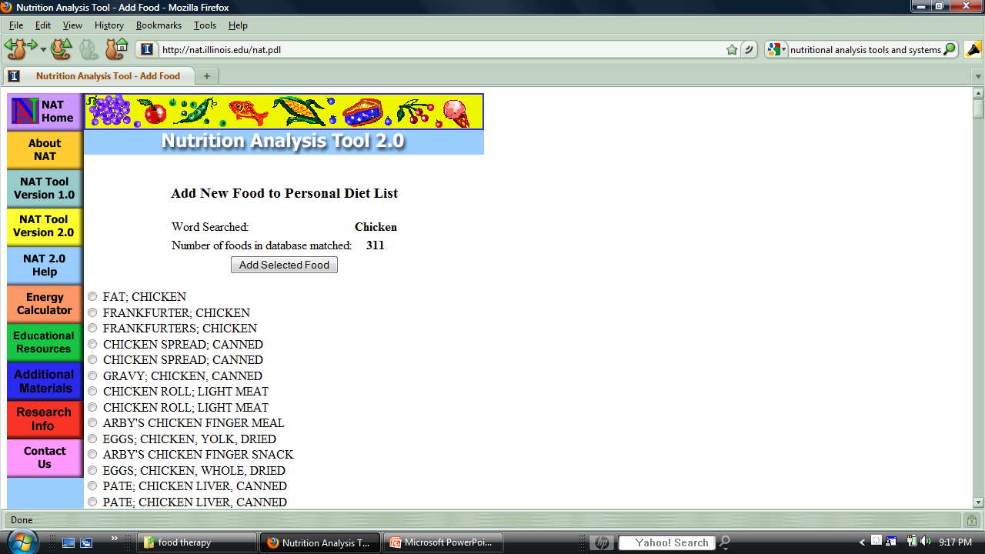
Si Jun Zi Tang Food

Slide 28
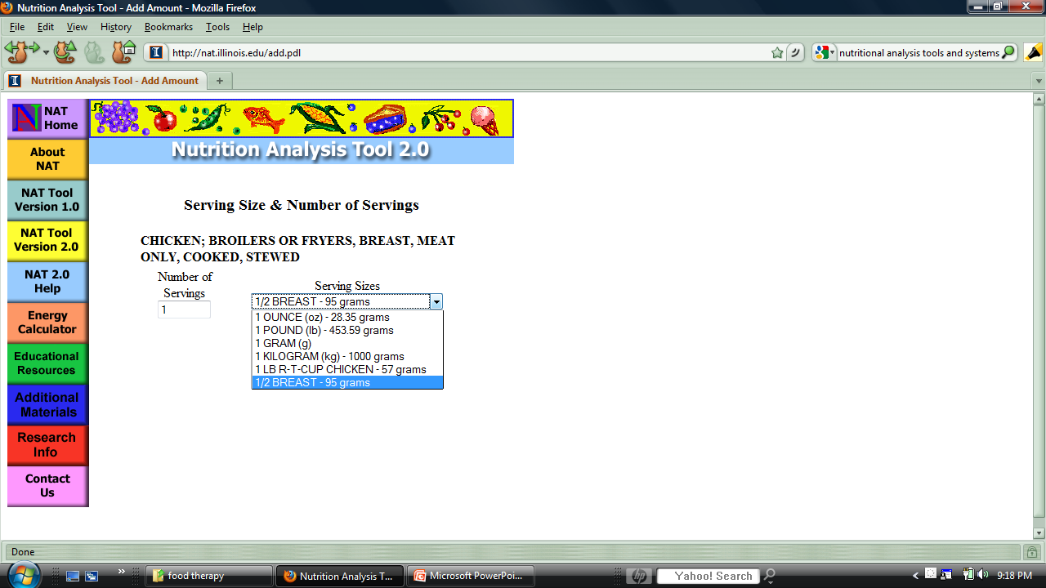
Si Jun Zi Tang Food

Slide 29
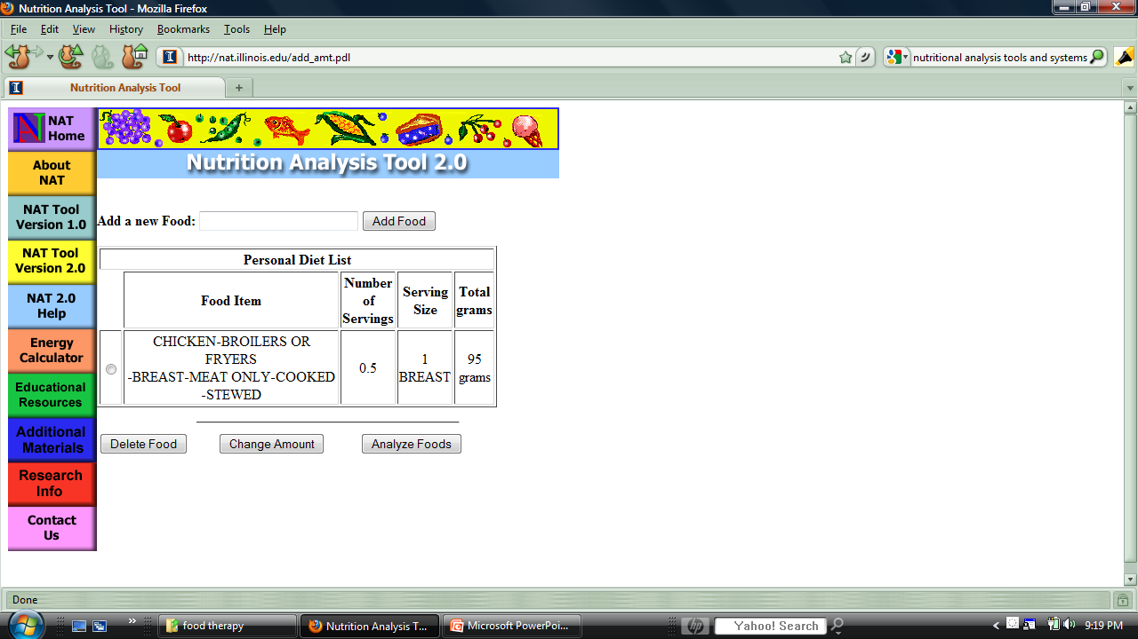
Si Jun Zi Tang Food

Slide 30
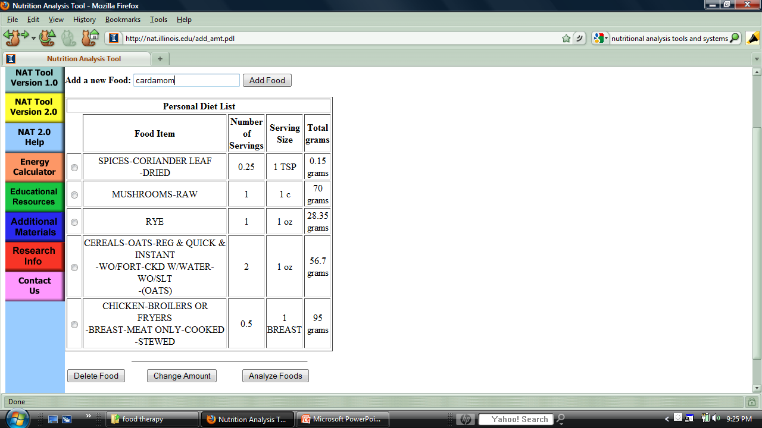
Si Jun Zi Tang Food

Slide 31
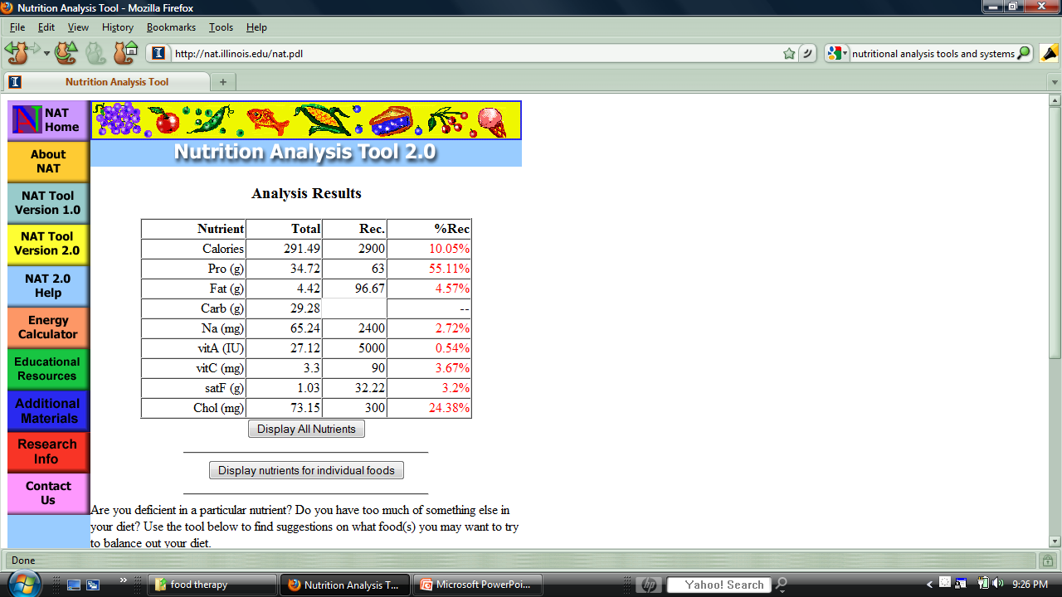
Si Jun Zi Tang Food

Slide 32
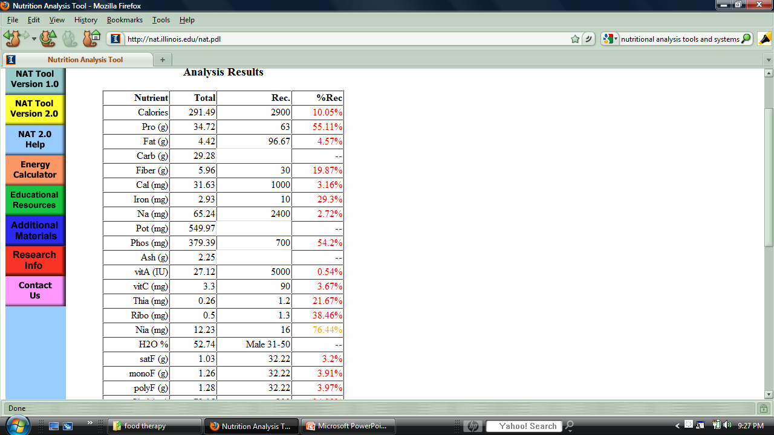
Si Jun Zi Tang Food

Slide 33
Si Jun Zi Tang Food
Chicken breast cooked ½ breast
Instant oats , cooked 2 oz
Rye, cooked 1 oz
Mushrooms 1 cup
Coriander ¼ tsp
Cardamom ¼ tsp
Calcium 500 mg
Calories 291 P-F-C 48-14-40

Slide 34
Spleen Qi Deficiency with Damp
Shen Ling Bai Zhu San Ginseng, Poria, and Atractylodes Powder
  Ren shen ginseng
  Bai zhu white atractylodes
  Fu ling poria
  Zhi gan cao honey-fried licorice
  Shan yao dioscorea
  Bai bian dou dolichoris lablab
  Lian zi nelumbinis
  Yi yi ren coix
  Sha ren amomum
  Jie geng platycodon
Augments the Qi, strengthens the Spleen, leaches out Dampness and stops diarrhea

Slide 35
Shen Ling Bai Zhu San Ginseng, Poria, and Atractylodes Powder
Ren shen ginseng, Bai zhu white atractylodes, Fu ling poria, and Zhi gan cao honey-fried licorice are Si Jun Zi Tang
Shan yao dioscorea tonifies the Spleen and supports the chief herbs
Bai bian dou dolichoris lablab and Lian zi nelumbinis strengthen the Spleen and stop diarrhea
Yi yi ren coix strengthens the Spleen and leaches out Dampness
Sha ren amomum transforms Dampness and promotes Qi movement
Jie geng platycodon unblocks the flow of Lung Qi

Slide 36
Shen Ling Bai Zhu San
Food Therapy
Ren shen ginseng, Bai zhu white atractylodes, Fu ling poria, and Zhi gan cao honey-fried licorice are Si Jun Zi Tang
  Warm, sweet Chicken which enters the Spleen and Stomach to Tonify Qi
  Warm, sweet Oats to strengthen the Spleen and dry Dampness
  Cool, sweet Mushroom to leech Dampness and mildly tonify Spleen Qi
  Neutral, sweet and sour Coriander to direct the actions to the middle burner and mildly warm the Spleen and Stomach
Yam and/or Sweet potato are neutral, sweet and tonify the SP
Pumpkin is sweet, neutral and dries Damp in the GI tract
Rutabaga is sweet, bitter, tonifies SP, circulates Qi, dries Damp
Aduki bean is neutral, sweet, sour and dries Damp and Water
Black pepper is sweet, pungent and hot, and transforms Damp and Phlegm

Slide 37
Shen Ling Bai Zhu San Food
Chicken breast cooked ½ breast
Instant oats , cooked 2 oz
Rye, cooked 1 oz
Mushrooms 1 cup
Yam, cooked 3 oz
Pumkin, cooked 2 oz
Rutabagas, cooked 2 oz
Aduki Bean, cooked 2 oz
Coriander ¼ tsp
Cardamom ¼ tsp
Black Pepper ¼ tsp
Calcium 750 mg
Calories 663 P-F-C 29-12-60

Slide 38
Spleen Yang Deficiency: Introduction
Cold from Deficiency in the Middle Burner
Disrupts Qi Mechanism
Principle signs
  Epigastric and abdominal distention and pain
  Fatigue
  Cold extremities
  White, slippery tongue coating
  Slow, deep pulse

Slide 39
Spleen Yang Deficiency: Herbal Formula
Li zhong wan or Regulate the Middle Pill
Actions: Warms the middle burner and strengthens the Spleen and Stomach

Slide 40
Spleen Yang Deficiency:
Li zhong wan
Indications: diarrhea with watery stool, nausea and vomiting, little thirst, loss of appetite, abdominal pain
Tongue: pale with white coat
Pulse: thin, deep

Slide 41
Spleen Yang Deficiency:
Li zhong wan
Zingiberis officinalis gan jiang warms the Spleen and Stomach Yang and dispels interior Cold
Radix ginseng ren shen strongly tonifies the Yuan Qi and reinforces the Yang
Atractylodis macrocephalae bai zhu tonifies SP/ST and dries damp
  One warming, one tonifying, one drying
Glycyrrhizae uralensis zhi gan cao augments the middle burner Qi

Slide 42
Spleen Yang Deficiency
Food Therapy
Lamb is sweet, hot, enters the Spleen and Kidney and tonifies Yang
Sweet potato is sweet, warm, enters the Kidney and Spleen and tonifies Yin and Qi and dispels Cold
Corn is sweet, neutral, enters the KI, LI and ST, tonifies Qi and dries damp
Fenugreek seed is warm, bitter, circulates Qi and tonifies Yang
  Or Ginger as in Li zhong wan

Slide 43
Li zhong wan Food
Lamb 5 oz
Mashed sweet potato 3 oz
Yellow corn 3 oz
Ginger 5 slices
Fenugreek 1 tsp
Calcium 500 mg
Calories 452 P-F-C 40-22-40

Slide 44
Stomach Heat
Bai Hu Tang White Tiger Decoction
  Shi gao gypsum
  Zhi mu anemarrhena
  Zhi gan cao honey fried licorice
  Geng mi nonglutinous rice
Clears Qi-level Heat, drains Stomach Fire, generate fluids, and alleviates thirst

Slide 45
Bai Hu Tang White Tiger Decoction
Shi gao gypsum is sweet, acrid and extremely cold to Clear Heat and Drain Fire
Zhi mu anemarrhena is bitter, cold and moistening, Clears Heat and enriches Yin
Zhi gan cao honey fried licorice and Geng mi nonglutinous rice benefit the Stomach and protect the fluids, and protect the middle Jiao from the first two cold ingredients

Slide 46
Bai Hu Tang Food Therapy
Crab is cold, salty, enters the Liver and Stomach, nourishes Yin and Clears Heat
Millet is cool, sweet, salty, enters the Kidney, Spleen and Stomach and Clears Heat
Squash is warm, sweet, enters the Spleen and Stomach, tonifies Qi and protects from Cold
Coriander is neutral, sweet, bitter, enters the Stomach and protects from the Cold

Slide 47
Bai Hu Tang Food
Crab 4 oz
Cooked millet 3 oz
Zucchini squash 4 oz
Coriander 1 tsp
Calcium 300 mg
Calories 246 P-F-C 47-8-42

Slide 48
Food and Qi Stagnation
Yue Ju Wan Escape Restraint Pill
  Cang zhu red/grey atractylodes
  Chuan xiong ligusticum
  Xiang fu cyperus
  Shan zhi zi gardenia
  Shen qu massa fermentata
Promotes the movement of Qi and releases constraint; “Five Stagnation” (Qi, blood, food, phlegm and heat)

Slide 49
Yue Ju Wan Escape Restraint Pill
Cang zhu red/grey atractylodes dries Dampness and resolves Phlegm
Chuan xiong ligusticum releases constrained Blood to resolve fixed pain
Xiang fu cyperus releases constraint and disperses Qi Stagnation
Shan zhi zi gardenia clears Heat from Sanjiao, resolves Fire from constraint and acid reflux
Shen qu massa fermentata relieves constraint caused by food stagnation

Slide 50
Yue Ju Wan Food Therapy
Crab is cold, salty, enters the Kidney and Stomach and circulates Blood
If crab is unavailable, Chicken is warm, sweet, enters the SP/ST and circulates Blood
Carrot is neutral, sweet, enters the Liver, Lung, and Spleen and circulates Qi
Wheat germ is cold, sweet, enters the Heart and Stomach and circulates Blood
Garlic is hot, sweet, pungent, enters the Heart, Liver, Lung and Stomach, resolves Damp, Phlegm and circulates Qi

Slide 51
Yue Ju Wan Food
Crab 4 oz
Carrots 1 cup
Wheat germ 3 oz
Garlic 2 cloves
Calcium 1000 mg
Calories 510 P-F-C 37-18-50

Slide 52
Megacolon: Dryness due to Heat
Ma Zi Ren Wan Hemp Seed Pill
  Huo ma ren cannabis seed
  Xing ren apricot seed
  Shao yao peony
  Zhi shi immature bitter orange
  Hou po magnolia cortex
  Da huang rhubarb
Moisten the Intestines, drains Heat, promotes Qi movement, unblocks the bowels

Slide 53
Ma Zi Ren Wan
Hemp Seed Pill
Huo ma ren cannabis seed moistens the intestines and unblocks the bowels
Xing ren apricot seed directs Qi downward and moistens the intestines
Bai Shao yao peony nourishes the Yin and harmonizes the interior
Zhi shi immature bitter orange breaks up accumulation, especially in the intestines
Hou po magnolia cortex removes fullness and distension
Da huang rhubarb is a purgative

Slide 54
Ma Zi Ren Wan Food Therapy
Rabbit is cool, sweet, nourishes Qi and Yin and enters the Large Intestine and Liver channels
If Rabbit is unavailable, Beef is neutral, sweet, nourishes Yin, Qi and Blood and enters the SP, ST and LI
Alfalfa sprouts are neutral, salty and bitter, nourish Yin and Blood and enter the LI
Cabbage is neutral sweet and pungent, enters the ST and LI and dispels Heat
Tofu is cool, sweet, nourishes Yin and enters the Spleen, Stomach and Large Intestine
Honey is neutral, sweet, enters the Lung, ST and LI and moistens the bowel
Saffron is neutral, sweet and circulates Qi

Slide 55
Ma Zi Ren Wan Food
Rabbit 5 oz
Alfalfa sprouts 1 oz
Cooked cabbage 3 oz
Tofu, firm 4 oz
Honey 1 oz
Saffron ¼ tsp
Calcium 200 mg
Calories 505 P-F-C 44-31-24

Slide 56
Historical TCM Example of “Food as Medicine”
Dang gui sheng jiang yang rou tang or Mutton stew with Angelica and Fresh Ginger Decoction
  Angelica sinensis dang gui
  Zingiberis officinalis recens sheng jiang
  Mutton yang rou
Actions: Warms the interior, nourishes Blood and alleviates pain

Slide 57
Geriatrics and Food Therapy
The astute veterinarian can already see that Raw Foods, although commonly healthful for young, active, warm animals, may be too cooling and stagnating for geriatric, inactive, cool animals
This is compounded when there is a concurrent Spleen Qi or Yang deficiency

Slide 58
Geriatrics, Processing and Xing
Important!
Cooking generally adds “warmth” to foods
Because Warm Transformation is decreased with age
Warming and moving foods more important

Slide 59
Conclusion
TCVM Food Therapy is as important as Acupuncture and Herbal Medicine to facilitate complete healing
Classical Herbal Formula strategies may be used to construct TCVM Food Therapy formulas
Knowledge of Food Energetics is necessary to understand and develop food therapy formulas

Slide 60
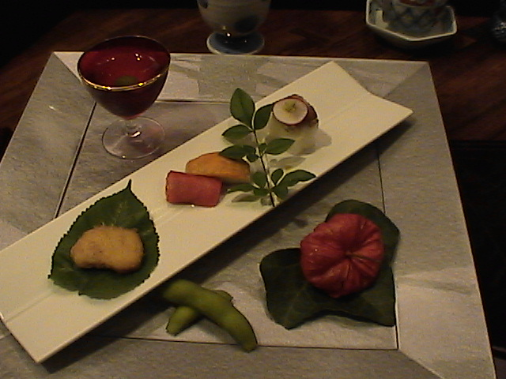
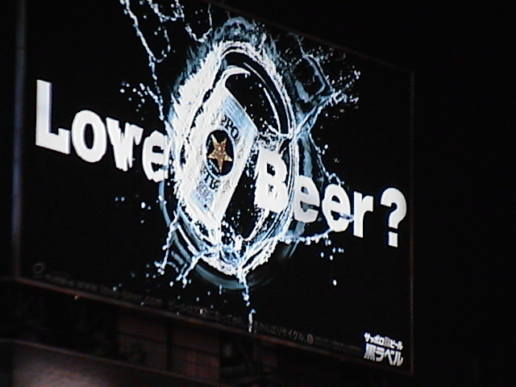
Another Way for TCVM Feeding
Use a balanced base food
Supplement for constitution, disorders or deficiencies
Add additional therapy as needed

Slide 61
Base TCVM Diet for Dogs
3 oz chicken heart
2 oz turkey breast
3 oz ground beef
3 oz beef kidney
2 oz beef liver
3 oz white fish
4 oz tofu
2 sardines in olive oil
1 T olive oil
1/2 c broccoli
1/2 c carrots
2 oz mushrooms
1/2 c spinach
1/4 c red peppers
1/4 c green peppers
1 T vinegar
1 clove garlic
1500 mg calcium
Contains 1250 calories with a 48/11/42 percent protein/carbohydrate/fat content.

Slide 62

Deficient Fire Food
4 oz chicken heart
4 oz chicken
4 oz lamb
1/8 t cayenne
750 mg calcium
Contains 800 calories with a 47/1/52 percent protein/carbohydrate/fat content.

Slide 63
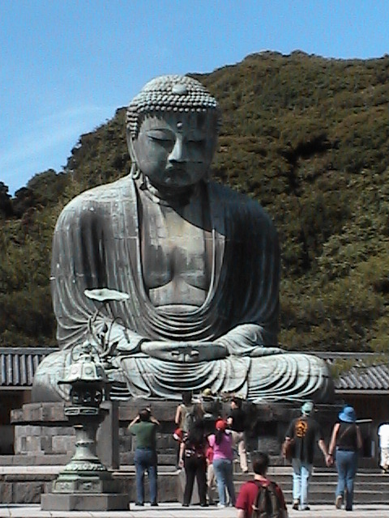
Deficient Earth Food
1 T fresh ginger
4 oz ground beef
4 oz sweat bread
750 mg calcium
Contains 665 calories with a 34/1/65 percent protein/carbohydrate/fat content.

Slide 64
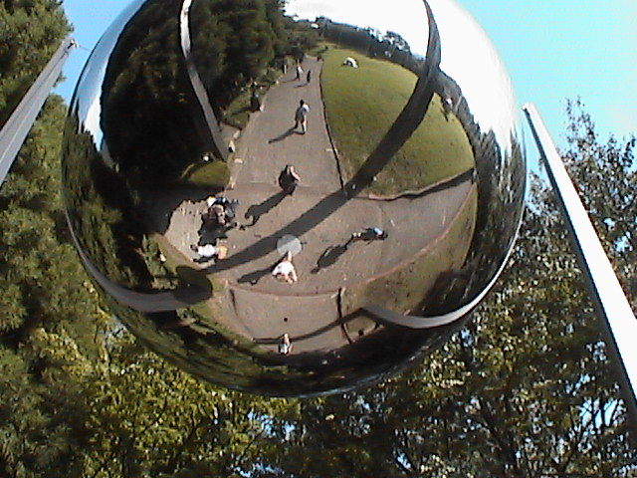
Deficient Metal Food
8 oz rice
4 chicken egg
4 oz egg plant
600 mg calcium
Contains 650 calories with a 20/36/44 percent protein/carbohydrate/fat content.

Slide 65
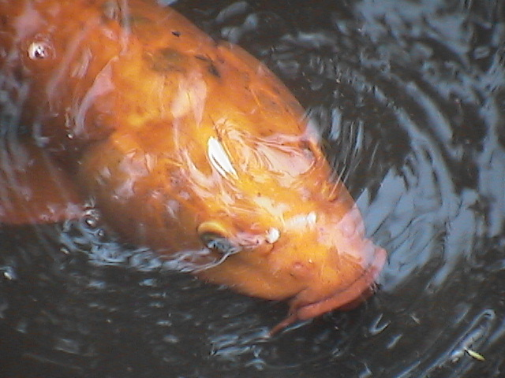
Deficient Water Food
2 oz bamboo shoots
4 oz pork
4 oz duck
600 mg calcium
Contains 572 calories with a 42/1/57 percent protein/carbohydrate/fat content.

Slide 66
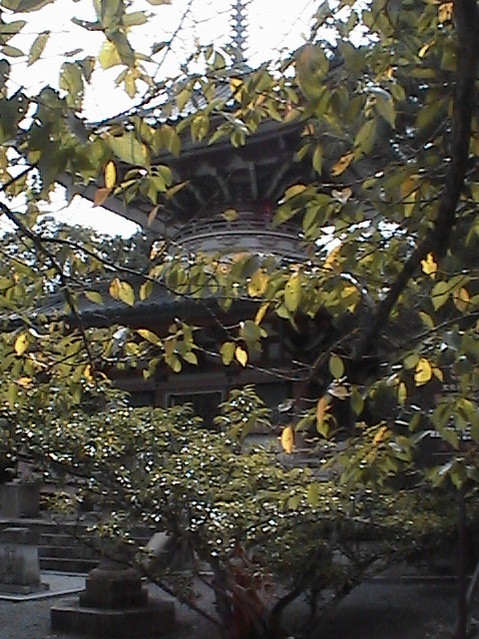
Deficient Wood Food
3 oz chicken liver
1/2 c asparagus
4 oz chicken
600 mg calcium
Contains 356 calories with a 61/6/33 percent protein/carbohydrate/fat content.

Slide 67
Qi Tonic Food
4 oz ground beef
4 oz beef liver
1 T olive oil
1/4 cup spinach
3 oz string beans
1000 mg calcium
Contains 704 calories with a 37/10/53 percent protein/carbohydrate/fat content.

Slide 68
Yang Tonic Food
4 oz lamb kidney
1 T olive oil
1/4 t cinnamon
1/2 t fennel
1/4 cup red pepper
400 mg calcium
Contains 290 calories with a 38/6/56 percent protein/carbohydrate/fat content.

Slide 69
Yin Tonic Food
4 eggs
2 oz chicken liver
1 T olive oil
4 oz cheddar cheese
4 oz firm tofu
500 mg calcium
Contains 1225 calories with a 27/3/70 percent protein/carbohydrate/fat content.

Slide 70
Blood Tonic Food
4 oz ground beef
4 eggs
1 T olive oil
2 oz seaweed
500 mg calcium
Contains 958 calories with a 25/20/55 percent protein/carbohydrate/fat content.

Slide 71
To Use TCVM Food
Use 50% of diet as base food
Add 25% for any deficiency
  Fire
  Earth
  Metal
  Water
  Wood
Add 25% of Grandparent for excess
Add 25 % of Grandchild if balanced
Add 25% tonic
  Qi
  Yang
  Yin
  Blood

Slide 72
Stagnation Food
4 oz ground beef
½ t cardamom
½ t basil
¼ t cloves
0.1 t cayenne
2 oz seaweed
1 oz carrot
½ t turmeric
1 T apple cider vinegar
250 mg calcium
Contains 335 calories with a 37/5/58 percent protein/carbohydrate/fat content.

Slide 73
Damp Elimination Food
3 oz mackerel
2 oz pumpkin
2 oz Rutabaga
2 oz turnip
3 oz mushroom
1 T parsley
1 t coriander
2 oz kidney beans
¼ cup turnip greens
600 mg calcium
Contains 395 calories with a 31/33/36 percent protein/carbohydrate/fat content.

