Slide 1
How to Support Endocrine Disorders with TCVM Food Therapy

Slide 2
Introduction
Pattern Differentiation is the Key
Yi Bing Tong Zhi
One disease, different treatments
Tong Bing Yi Zhi
Different diseases, one treatment
Western Biomedical “endocrine disease” is not a classical TCVM Pattern
Multiple TCVM Patterns may be included in the Western Biomedical diagnosis of “endocrine” disorder

Slide 3
TCVM Endocrine?
“Endocrine” disorders were not typically classified as TCVM Patterns
TCVM analysis of modern Endocrine patterns include:
Kidney patterns (e.g. menopause is Kidney Yin Def)
Jing patterns (e.g. somatotropin is a form of Jing)
Liver patterns (e.g. some hyperthyroidism)
Spleen patterns (e.g. some hypothyroidism)

Slide 4
Hyperadrenocorticism: General
Spleen and Kidney Yang Deficiency with Dampness and Phlegm
Faulty diet
Overwork
Aging
Long-term disease
Iatrogenic
Phlegm
Inappropriate diet
Long-term accumulation and congealing of Dampness
Long-term Heat that stews and steams Body Fluids
Yin Deficiency with Fire
Jing Deficiency
Aging, long-term disease
Iatrogenic

Slide 5
Hyperadrenocorticism Patterns
Yin Deficiency with Liver Yang Rising
Yin Deficiency with False Heat
Liver Yang Rising with Phlegm Fire
Yin Deficiency with Heat Toxin
Qi and Yin Deficiency
Spleen Qi Deficiency with Phlegm Damp
Spleen-Kidney Yang Deficiency
Yin and Yang Dual Deficiency

Slide 6
Which Food Categories Most Important?
Yin Tonics
alfalfa sprout, apple, apricot, asparagus, avocado, banana, barley, cheese, chicken egg, clam, coconut milk, crab, duck, duck egg, honey, kelp, kidney bean, lemon, lima bean, malt, mango, milk, mung bean sprout, nettle, nori, plantain, oyster, pea, pear, pineapple, pork, potato, rabbit, spelt, string bean, sweet potato, tofu, tomato, water chestnut, watermelon, yam
Cooling Foods
Asparagus, Bamboo Shoot, Banana, Kelp, Lettuce, Millet, Peppermint, White Potato and Tofu
Qi Tonics
Beef, Carrot, Chicken, Date, Fig, Lentil, Mackerel, Microalgae, Molasses, Oats, Rutabaga, Sweet Potato, Pumpkin and Squash

Slide 7
Which Food Categories Most Important?
Damp Regulating Foods
Alfalfa, Barley, Garlic, Green Tea, Job’s tears, Kidney Bean, Mackerel, Mushroom, Parsley, Pumpkin, Rutabaga, Rye and Turnip
Phlegm Regulating Foods
Almond, Apple Peel, Garlic, Licorice, Marjoram, Mushroom, Black and White Pepper, Peppermint, Plantain, Seaweed, Shitake Mushroom, Shrimp, Tea, Walnut and Watercress
Yang Tonics
anchovy, basil, cayenne, chestnut, chive seed, cinnamon bark, clove, dill seed, fennel seed, fenugreek seed, garlic, dried ginger, kidney, lamb, lobster, nutmeg, quinoa, pistachio, prawn, raspberry, rosemary, sage, shrimp, thyme, walnut

Slide 8
Yin Deficiency with Liver Yang Rising
Common signs:
Polyphagia
Polyuria, Polydipsia
Obesity
Hot face and ears
Headache
Agitation
Dry mouth
Lumbar and stifle soreness
Poor quality and quantity of sleep
Red tongue, may be peeled or no coat
Fine, tight to wiry, rapid pulse
Treatment Principles: Nourish Yin, subdue Yang

Slide 9
Yin Deficiency with Liver Yang Rising

Slide 10
Yin Deficiency with Liver Yang Rising
Zhi Bai Di Huang Wan, Anemarrhena, Phellodendron and Rehmannia Pill
Huang bai, Phellodendron
Zhi mu, Anemarrhena
Sheng di huang, uncooked Rehmannia
Shan yao, Dioscorea
Shan zhu yu, Cornus
Mu dan pi, Paeony root bark
Ze xie, Alisma
Fu ling, Poria
Modify with Gou Teng, Uncaria, to clear Liver Heat and pacify Liver Yang
Functions: Nourish Liver and Kidney Yin, reduce deficient Fire, clear Liver Heat and pacify Liver Yang

Slide 11
Zhi Bai Di Huang Wan, Anemarrhena, Phellodendron and Rehmannia Pill
Zhi Mu Anemarrhena clears Heat, nourishes Yin and moistens dryness
Huang Bai Phellodendron clears Heat, dries Dampness, clears Deficient Heat from Kidney Yin Deficiency
Shu di huang Rehmannia nourishes Yin and tonifies the Kidneys and Blood as well as replenishes essence
Two of the deputies, Shan zhu yu Cornus and Shan yao Dioscorea, tonify the Liver and nourish the Spleen to further benefit the Blood and essence

Slide 12
Zhi Bai Di Huang Wan, Anemarrhena, Phellodendron and Rehmannia Pill
The three assistants are Ze xie Alismatis, Fu ling Poria and Mu dan pi Moutan and their purpose is to regulate the Kidneys, Liver and Spleen
Ze xie unblocks the water pathways, Fu ling strengthens the Spleen and mildly drains Damp, and Mu dan pi clears Heat and soothes the Liver fire

Slide 13
Zhi Bai Di Huang Wan Food Therapy
Barley is cool, sweet and salty and nourishes Yin and Clears Heat
Yam is neutral, sweet and nourishes Yin, Qi and Jing
Beef nourishes Blood and possibly Yin
What nourishes Liver and Blood?
Which foods regulate the Spleen?
Which foods unblock the water pathways?

Slide 14
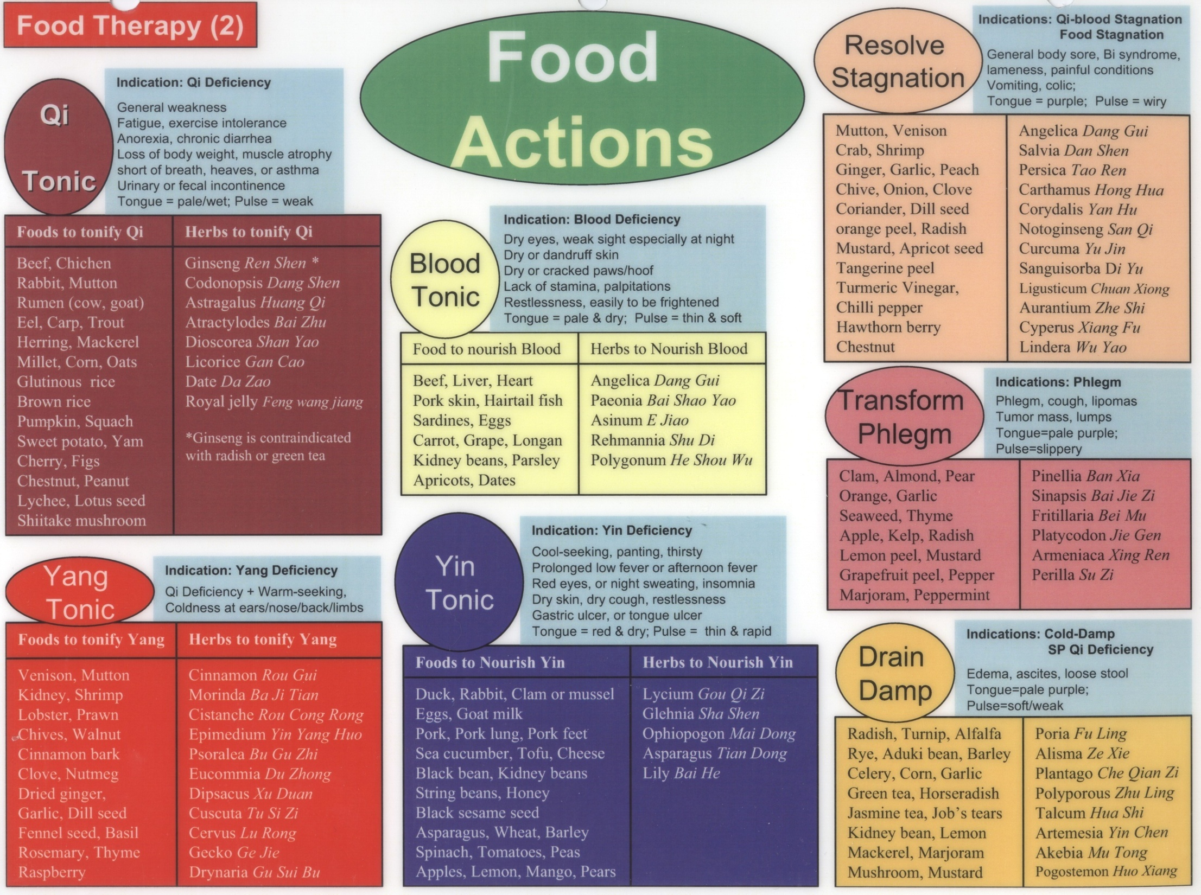

Slide 15
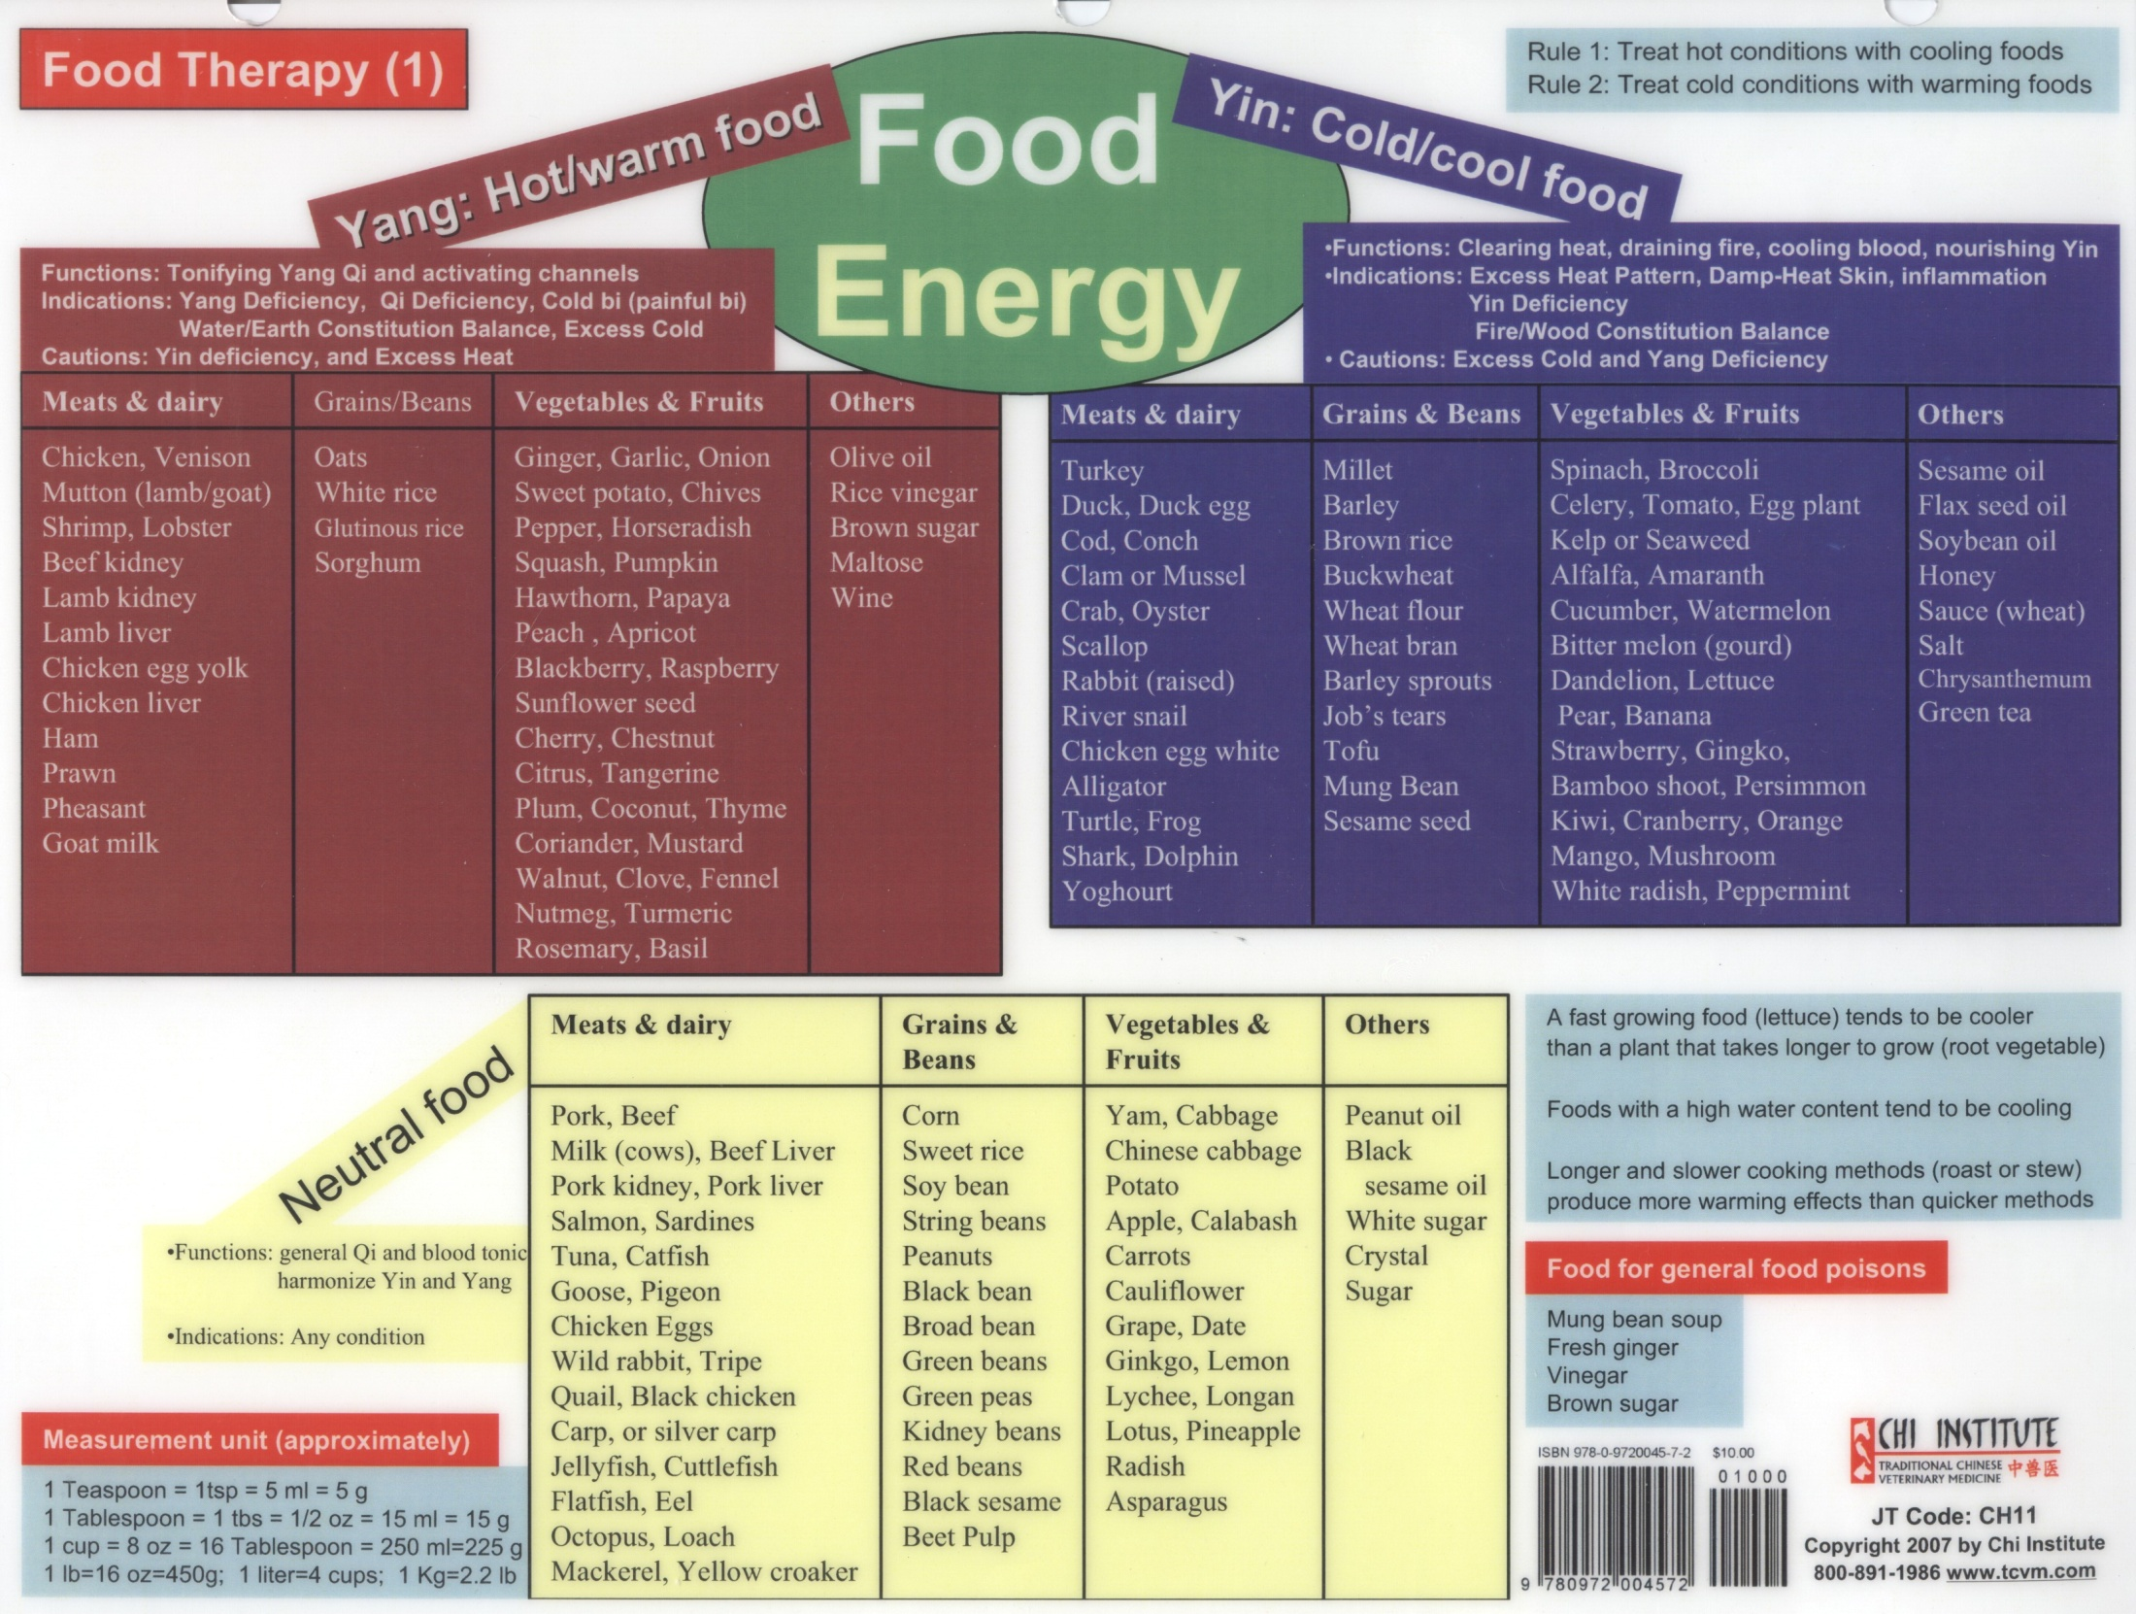

Slide 16
Zhi Bai Di Huang Wan Food
Barley 1 cup
Bamboo Shoots 2 oz
Mushrooms 3 oz
Beef 2 oz
Rabbit 4 oz
Yam ½ cup
Cherries 2 oz
Carrots ½ cup
Tomatoes 2 oz
Cucumber 2 oz
Calcium 600 mg
Calories 791 P-F-C 30-24-46

Slide 17
Yin Deficiency with False Heat
Common signs
Polyuria, Polydipsia
Pendulous abdomen with thin limbs
Nocturnal irritability
Dry mouth and throat
Lumbar and stifle weakness and pain
Insomnia, profuse dreaming
Constipation
Red tongue, especially tip, with little or no coat
Fine, deep, rapid pulse
Treatment Principles: Supplement the Kidneys and enrich Yin, clear and drain ministerial Fire

Slide 18
Yin Deficiency with False Heat

Slide 19
Yin Deficiency with False Heat
Ophiopogon Powder (A3510)
Mai men dong, Ophiopogon
Lu gen, Phragmites
Zhi mu, anemarrhena
Tian hua fen, Trichosanthes
Bei sha shen, Glehnia
Zhu ye, Bambusa
Ge gen, Pueraria
Wu mei, Mume
Huang qin, Scutellaria
Yu li ren, Prunus
Shan zha, Crataegus
Shen qu, Massa Fermentata
Actions: Nourish Yin, clear Heat, promote Body Fluids

Slide 20
Ophiopogon Powder Formula Analysis
Twelve herbs, half of them such as Mai Men Dong, Ophiopogon, and Tian Hua Fen, Trichosanthes, work together to Nourish Yin, generate fluids and Clear Heat
Assistants such as Ge Gen, Pueraria, and Lu Gen, Phragmites, promote body fluids
Shan Zha, Crataegus, and Shen Qu, Massa Fermentata, resolve food stasis
Finally, Wu Mei, Mume plum astringes

Slide 21
“Ophiopogon Powder” Food Therapy
What foods are cooling and clear heat while promoting body fluids?
Which foods relieve food stagnation? What’s the principal of Shen Qu?
Why would we want to add a sour astringent such as Wu Mei?

Slide 23
Zhi Bai Di Huang Wan Food
Mung Beans ½ cup
Radishes 2 oz
Tofu 6 oz
Spinach ½ cup
Kidney Beans ½ cup
Asparagus ½ cup
Rabbit 4 oz
Plum 1 oz
Mushroom ½ cup
Apple with peel 2 oz
Alfalfa sprouts 2 oz
Ginger 1 tsp
Calcium 500 mg
Calories 836 P-F-C 40-27-33

Slide 24
Yin Deficiency with False Heat
Zhi Bai Di Huang Wan, Anemarrhena, Phellodendron and Rehmannia Pill
Huang bai, Phellodendron
Zhi mu, Anemarrhena
Sheng di huang, uncooked Rehmannia
Shan yao, Dioscorea
Shan zhu yu, Cornus
Mu dan pi, Paeony
Ze xie, Alisma
Fu ling, Poria
Functions: Nourish Liver and Kidney Yin, reduce deficient Fire

Slide 25
Qi and Yin Deficiency
Common signs
Polyuria
Polydipsia
Pendulous abdomen or ascites
Pulmonary edema
Congestive heart failure
Enlarged liver
Excessive panting with outbursts at night
Pale or red tongue
Thready and weak pulse

Slide 26
Qi and Yin Deficiency

Slide 27
Qi and Yin Deficiency
Rehmannia 11 (A2194)
Huang Qi, Astragalus
Rou Gui, Cinnamon
Shu Di Huang, Rehmannia
Shan Yao, Dioscorea
Shan Zhu Yu, Cornus
Mu Dan Pi, Moutan
Fu Ling, Poria
Ze Xie, Alisma
Fu Pen Zi, Rubus
Jin Ying Zi, Rosa
Sang Piao Xiao, Mantidis
Actions: Tonify Qi, nourish Yin, astringently consolidate

Slide 28
Spleen Qi Deficiency with Phlegm Damp
Common signs
Obesity
Edema
Fatigue, lack of strength
Subdued Shen
Reduced food intake
Cold distal limbs
Loose stools
Pale, fat tongue with slimy white coat
Fine, weak pulse
Treatment Principles: Fortify the Spleen, transform Phlegm and eliminate Dampness

Slide 29
Spleen Qi Deficiency with Phlegm Damp

Slide 30
Spleen Qi Deficiency with Phlegm Damp
Liu Jun Zi Tang, Six Gentlemen Decoction
Ren Shen, Ginseng
Bai Zhu, White Atractylodes
Fu Ling, Poria
Chen Pi, Tangerine Peel
Ban Xia, Pinellia Tuber
Zhi Gan Cao, Honey-fried Licorice
Functions: Tonify the Spleen, resolve Dampness, transform Phlegm, stop vomiting

Slide 31
Liu Jun Zi Tang Six Gentlemen Decoction
the chief herb Panax ginseng ren shen is sweet, warm and tonifies Spleen Qi
the deputy herb Atractylodis macrocephalae bai zhu is bitter, warm and strengthens Spleen Qi and dries Dampness
the assistant herb Poria cocos fu ling is sweet, bland and leeches out Dampness and mildly Tonifies Spleen Qi
Chen Pi, Tangerine Peel regulates Qi, harmonizes the middle burner, dries Damp and resolves Phlegm
Ban Xia, Pinellia Tuber dries Damp, resolves Phlegm and stops vomiting
the envoy Glycyrrhizae uralensis gan cao is warm, sweet and warms and regulates the middle burner

Slide 32
Liu Jun Zi Tang Six Gentlemen Decoction
Warm, sweet Chicken which enters the Spleen and Stomach to Tonify Qi
Warm, sweet Oats to strengthen the Spleen and dry Dampness
Cool, sweet Mushroom to leech Dampness and mildly tonify Spleen Qi
Neutral, sweet and sour Coriander to direct the actions to the middle burner and mildly warm the Spleen and Stomach
Use acrid, warm, aromatic Cardamom (Sha Ren) if there is also Phlegm or vomiting

Slide 33
Spleen-Kidney Yang Deficiency
Common Signs
Polyuria
Polydipsia
Pendulous abdomen or ascites
Pulmonary edema
Congestive heart failure
Enlarged liver
Fatigue
Weak limbs
Warmth-seeking
Swollen and pale tongue
Deep and weak pulse

Slide 34
Spleen-Kidney Yang Deficiency

Slide 35
Spleen-Kidney Yang Deficiency
Rehmannia 14 (A0150)
Sheng Di Huang, uncooked Rehmannia
Shan Yao, Dioscorea
Bai Shao Yao, Paeony
Huang Qi, Astragalus
Zhi Mu, Anemarrhena
Huang Bai, Phellodendron
Wu Wei Zi, Schisandra
Mai Men Dong, Ophiopogon
Fu Ling, Poria
Ze Xie, Alisma
Gui Zhi, Cinnamon
Fu Zi, Aconite
Shan Zhu Yu, Cornus
Mu Dan Pi, Moutan
Actions: Nourish Yin, tonify Qi and Yang

Slide 36
Rehmannia 14 Formula Analysis
Of 14 herbs in this formula, seven nourish Yin and clear Heat
Shan Yao, Dioscorea, and Huang Qi, Astragalus tonify Qi
Gui Zhi, Cinnamom, and Fu Zi, Aconite tonify Yang and warm the interior
Ze Xie, Alisma, and Fu Ling, Poria help drain and regulate Damp

Slide 37
“Rehmannia 14” Food Therapy
Which foods nourish Yin and clear Heat?
What are some grain and vegetable Qi Tonics?
What foods warm the interior and tonify Yang?
Finally, which foods help regulate water and damp in the body?

Slide 39
Hypothyroidism: General
In non-humans, species-inappropriate diet may lead to Spleen Qi Deficiency
Excessive vaccinations or environmental toxins may cause Liver Qi Stagnation and Spleen injury
Chronic Spleen Qi Deficiency ultimately
Leads to fatigue
Leads to Yang Deficiency
Leads to Damp accumulation and Phlegm
May lead to Blood Stasis

Slide 40
Hypothyroidism Patterns
Spleen Qi Deficiency
Qi and Yin Deficiency
Yuan Qi Deficiency
Spleen-Kidney Yang Deficiency
Liver Stagnation Phlegm Nodulation
Congealed Phlegm and Blood Stasis

Slide 41
Which Food Categories Most Important?
Qi Tonics
bay, beef, cherry, chicken, coconut, corn, date, eel, fig, ginseng, grape, ham, herring, Job’s tears, lentil, licorice, longan, mackerel, Microalgae, molasses, mutton, oats, potato, rabbit, rice, royal jelly, rutabaga, sweet potato, shiitake mushroom, squash, tofu, trout, yam
Yin Tonics
alfalfa sprout, apple, apricot, asparagus, avocado, banana, barley, cheese, chicken egg, clam, coconut milk, crab, duck, duck egg, honey, kelp, kidney bean, lemon, lima bean, malt, mango, milk, mung bean sprout, nettle, nori, plantain, oyster, pea, pear, pineapple, pork, potato, rabbit, spelt, string bean, sweet potato, tofu, tomato, water chestnut, watermelon, yam

Slide 42
Which Food Categories Most Important?
Yang Tonics
Basil, Cinnamon Bark, Clove, Fennel Seed, Fenugreek Seed, Garlic, Dried Ginger, Kidney, Lamb, Rosemary, Shrimp, and Walnut
Phlegm Regulating Foods
Almond, Apple Peel, Garlic, Licorice, Marjoram, Mushroom, Black and White Pepper, Peppermint, Plantain, Seaweed, Shitake Mushroom, Shrimp, Tea, Walnut and Watercress
Blood Regulating Foods
Chestnut, Chili Pepper, Chive, Crab, Hawthorn Berry, Peach, Ginger, Turmeric and Vinegar

Slide 43
Spleen Qi Deficiency
Common Signs
Fatigue
Cold distal extremities
Obesity
Puffy edema
Tendency to loose stools
Fat, pale tongue with teeth-marks and thin white coat
Weak and soggy pulse

Slide 44
Spleen Qi Deficiency

Slide 45
Spleen Qi Deficiency
Bu Zhong Yi Qi Tang, Reinforce the Middle Burner and Tonify Qi Decoction
Ren Shen, Panax Ginseng
Huang Qi, Astragalus
Bai Zhu, Atractylodes
Dang Gui, Angelica sinensis
Chen Pi, ripe Tangerine Peel
Chai Hu, Bupleurum
Sheng Ma, Cimicifuga
Zhi Gan Cao, honey-fried Licorice
Actions: Tonifies the Spleen and Stomach Qi, lifts the Yang Qi

Slide 46
Bu Zhong Yi Qi Tang Formula Analysis
Huang Qi, Astragalus, Ren Shen, Ginseng, Bai Zhu, Atractylodes, and Zhi Gan Cao, Licorice are complementary Qi Tonics
Assistant Dang Gui, Angelica sinensis works with Huang Qi to augment Qi via Blood
Assistant Chen Pi, Citrus, regulates Qi
Envoys Sheng Ma, Cimicifuga, and Chai Hu, Bupleurum help raise the sunken Yang Q

Slide 47
“Bu Zhong Yi Qi Tang” Food Therapy
What is a simple yet complete Qi Tonic formula for a carnivore?
What can we add to help regulate the Qi in the Spleen/Stomach?
Are there foods that raise Yang Qi?

Slide 49
Qi and Yin Deficiency
Common Signs
Aversion to Cold
Cold extremities
Cold and painful lumbar area
Loose teeth
Deafness or hearing loss
Copious clear urine
Urinary incontinence
Lethargy and exercise intolerance
Dry, flakey skin
Increased shedding
Bilateral symmetrical hair loss
Loose, dry, thickened and darkly pigmented skin
Weight gain without increased appetite or caloric consumption
Weak vocalizations
Constipation or diarrhea
Swollen, pale, thin moist or red and dry tongue
Weak, deep pulse

Slide 50
Qi and Yin Deficiency
Jia Bing Feng (A2201)
Huang Qi, Astragalus
Dang Shen, Condonopsis
He Shou Wu, Polygonum
Shu Di Huang, Rehmannia
Bai Shao Yao, Peony
Shan Yao, Dioscorea
Xia Ku Cao, Prunella
Xiang Fu, Cyperus
Chai Hu, Bupleurum
Hai Zao, Sargassum
Kun Bu, Laminaria
Actions: Tonify Qi, nourish Yin and Blood, Transform Phlegm and soften hardness

Slide 51
Jia Bing Feng Formula Analysis
Of eleven herbs in this formula, three Tonify Qi
Three herbs nourish Blood and Jing
Three herbs function to soothe Liver Qi
Finally, two sea vegetables, Hai Zao, Sargassum, and Kun Bun, Laminaria, are used to transform Phlegm and soften hardness

Slide 52
“Jia Bing Feng” Food Therapy
Name at least one meat, grain and vegetable that may Tonify Qi
Which foods nourish Blood and Jing?
What things may soothe Liver Qi?
We can easily add sea vegetables such as, Hai Zao, Sargassum, and Kun Bun, Laminaria, to transform Phlegm and soften hardness

Slide 53
Foods to Soothe the Liver and Relieve Stagnation
Pungent and Raw Foods
Watercress, onions, mustard greens, turmeric, basil, bay, cardamom, marjoram, cumin, fennel, ginger, black pepper, rosemary, various mints, sprouted grains, beans, seeds, fresh vegetables, fruit
Foods which Harmonize the Liver
Honey, apple cider vinegar, licorice root, molasses, barley malt
Bitter and Sour Foods
Rye, romaine lettuce, asparagus, amaranth, quinoa, alfalfa, citrus peel, dandelion root, bupleurum, milk thistle, chamomile
Detoxifying and Cooling
Mung beans, celery, seaweeds, cucumber, watercress, millet, mushrooms, daikon radish, rhubarb root

Slide 54
Yuan Qi Deficiency
Common Signs
Developmental abnormalities (i.e. bone and tendon)
Muscular problems
Poor exercise tolerance or weakness
Warm-seeking of decreased body temperature
Goiter
Scaly hair coat
Edema
Pale tongue with white coating
Deep, weak pulse

Slide 55
Yuan Qi Deficiency
Xiao Ying Powder (A2204)
Tu Si Zi, Cuscuta
Rou Cong Rong, Cistanche
He Shou Wu, Polygonum
Xuan Shen, Scrophularia
Hai Dai, Zostera
Hai Ge Ke, Cyclina
Hai Zao, Sargassum
Hai Piao Xiao, Sepia
Kun Bu, Laminaria
Actions: Tonify Kidney Jing and Yuan Qi, transform Phlegm, soften hardness

Slide 56
Liver Stagnation Phlegm Nodulation
Common Signs
Wood Personality
Goiter or obvious thyroid enlargement
Emotional problems
Purple or slightly red tongue
Wiry or string-taut pulse

Slide 57
Liver Stagnation Phlegm Nodulation

Slide 58
Liver Stagnation Phlegm Nodulation
Si Hai Powder (A2203)
Mu Xiang, Saussurea
Chen Pi, ripe Tangerine Peel
Hai Dai, Zostera
Hai Ge Ke, Cyclina
Hai Zao, Sargassum
Hai Piao Xiao, Sepia
Kun Bu, Laminaria
Actions: Soothe Liver and resolve Stagnation and eliminate enlarged thyroid

Slide 59
Hyperthyroidism: General
Disease mechanism related to Liver
If Liver Stagnation is not rectified, the Qi Mechanism may become depressed and stagnate
Leads to Dampness and Phlegm congealing
Enduring Stagnation may transform to Fire
Heat from Stagnation may “draft” Phlegm up the Heart Orifices and harass the Shen
Heat from Stagnation may damage Yin Fluids leading to Yin Deficiency with Yang Rising
“Strong Fire eats Qi” leading to further Yin and Qi damage

Slide 60
Hyperthyroidism: Summary
Disease Mechanism is combination of Excess and Deficiency
Root Deficiency
Yin Deficiency
Qi Deficiency
If severe, Yang Deficiency
Branch Excess
Qi Stagnation
Congealed Phlegm
Blood Stasis

Slide 61
Hyperthyroidism Patterns
Qi Stagnation and Congealed Blood and Phlegm
Excess Liver Fire
Yin Deficiency with Yang Excess
Qi and Yin Dual Deficiency

Slide 62
Which Food Categories Most Important?
Qi Regulation
Basil, Cardamom, Carrot, Cayenne, Clove, Coriander, Garlic, Hawthorn Berry and Turmeric
Blood Regulation
Chestnut, Chili Pepper, Chive, Crab, Hawthorn Berry, Peach, Ginger, Turmeric and Vinegar
Resolve Phlegm
Almond, Apple Peel, Garlic, Licorice, Marjoram, Mushroom, Black and White Pepper, Peppermint, Plantain, Seaweed, Shitake Mushroom, Shrimp, Tea, Walnut and Watercress

Slide 63
Which Food Categories Most Important?
Drain Fire/Cooling
Asparagus, Bamboo Shoot, Banana, Kelp, Lettuce, Millet, Peppermint, White Potato and Tofu
Tonify Yin
alfalfa sprout, apple, apricot, asparagus, avocado, banana, barley, cheese, chicken egg, clam, coconut milk, crab, duck, duck egg, honey, kelp, kidney bean, lemon, lima bean, malt, mango, milk, mung bean sprout, nettle, nori, plantain, oyster, pea, pear, pineapple, pork, potato, rabbit, spelt, string bean, sweet potato, tofu, tomato, water chestnut, watermelon, yam

Slide 64
Qi Stagnation and Congealed Blood and Phlegm
Common Signs
Irritability
Anxiety
Depression
Goiter which is soft and non-painful
Tendency to sighing
Painful or reactive hypochondriac region
Bluish-dark red tongue with thin white coat
Wiry, slippery pulse

Slide 65
Qi Stagnation and Congealed Blood and Phlegm
Xiao Yao San, Rambling Powder
Chai hu bupleurum
Dang gui angelica sinensis
Bai shao yao white peony
Bai zhu white atractylodes
Fu ling poria
Bo he peppermint
Wei jiang roasted ginger
Zhi gan cao honey-fried licorice
Disperses Liver Qi, relieves stagnation, tonifies Spleen Qi, nourishes Blood

Slide 66
Xiao Yao San Formula Analysis
The chief herb Chai Hu, Bupleurum, relieves Liver constraint
Deputies Dang Gui, Angelica sinensis, and Bai Shao Yao, Peony, nourish Blood to soften Liver
Assistants Bai Zhu, Atractyoldes, and Fu ling, Poria, strengthen the Spleen and T & T function
Assistants Zhi Gan Cao, honey-fried Licorice and Bai Shao Yao, Peony, moderate spasmodic abdominal pain
Envoy Wei Jiang, Zingiber harmonizes the Stomach
Envoy Bo He, Mentha harmonizes and cools Liver

Slide 67
“Xiao Yao San” Food Therapy
Foods to Soothe the Liver and Relieve Stagnation
Pungent and Raw Foods
Watercress, onions, mustard greens, turmeric, basil, bay, cardamom, marjoram, cumin, fennel, ginger, black pepper, rosemary, various mints, sprouted grains, beans, seeds, fresh vegetables, fruit
Foods which Harmonize the Liver
Honey, apple cider vinegar, licorice root, molasses, barley malt
Bitter and Sour Foods
Rye, romaine lettuce, asparagus, amaranth, quinoa, alfalfa, citrus peel, dandelion root, bupleurum, milk thistle, chamomile
Detoxifying and Cooling
Mung beans, celery, seaweeds, cucumber, watercress, millet, mushrooms, daikon radish, rhubarb root

Slide 68
Qi Stagnation and Congealed Blood and Phlegm
Xiao Chai Hu Tang, Minor Bupleurum Decoction
Chai Hu, Bupleurum
Huang Qin, Scuttelaria
Ren Shen, panax Ginseng
Ban Xia, Pinellia
Zhi Gan Cao, honey-fried licorice
Sheng Jiang, fresh Ginger
Da Zao, Jujube
Additions: Xia Ku Cao, Mu Li, Zhe Bei Mu and Kun Bu
Actions: harmonizes Shaoyang and softens nodules

Slide 69
Qi Stagnation and Congealed Blood and Phlegm
Sargussum Jade Pot (A2211)
Hai Zao, Sargassum
Kun Bu, Laminaria
Hai Dai, Zostera
San Leng, Sparganium
E Zhu, Zedoaria
Ban Xia, Pinellia
Chen Pi, Ripe Tangerine Peel
Qing Pi, Green Tangerine Peel
Lian Qiao, Forsythia
Chuan Bei Mu, Fritillaria
Dang Gui, Angelica sinensis
Chuan Xiong, Ligusticum
Du Huo, Angelica pubescens
Actions: Soften swelling, Move Qi, dissolve Phlegm, break up masses

Slide 70
Excess Liver Fire
Common Signs
Goiter which is soft and non-painful
Emotional tension
Irritability
Red eyes
Headache
Dizziness and tinnitus
Tongue and skin shaking/fasiculation
Insomnia
Calorophobic
Panting
Hunger with increased food intake
Profuse drinking
Bitter taste in mouth
Red tongue with yellow coat
Bowstring, rapid pulse

Slide 71
Excess Liver Fire
Long Dan Xie Gan Tang
Long Dan Cao 6g
Huang Qin 9g
Zhi Zi 9g
Mu Tong 6g
Ze Xie 9g
Chai Hu 6g
Sheng Di Huang 6g
Dang Gui 3g
Sheng Gan cao 6g
Additions: Xia Ku Cao, Xuan Shen, Mu Li, Ban Xia, Zhe Bei Mu, Hai Zao and Kun Bu
Actions: Clear the Liver and drain Fire, transform Phlegm and scatter nodulation

Slide 72
Yin Deficiency with Yang Excess
Common Signs
Enlarged thyroid
Weight loss
Emaciation
Irritability, restless, hyperactive or aggressive
Insomnia
Panting
Tremors of tongue and skin
Increased appetite
Fatigue
Loose stools
Vomiting
Tachycardia
Hot feet and chest center
Exophthalmos
Photophobia
Red, dry tongue
Wiry, rapid, floating and thin pulse

Slide 73
Yin Deficiency with Yang Excess

Slide 74
Yin Deficiency with Yang Excess
Hyper Jia Bing Formula (A2212)
Shu Di Huang, Rehmannia
Shan Yao, Dioscorea
Shan Zhu Yu, Cornus
Bai Shao Yao, Paeonia
Ze Xie, Alisma
Mu Li, Ostrea
Long Gu, Draconis
Xiang Fu, Cyperus
Chai Hu, Bupleurum
Actions: Tonify Yin and pacify Yang

Slide 75
Yin Deficiency with Yang Excess
Tian Wan Bu Xin Dan, Heavenly Emperor Supplement and Heart Elixir
Yi Guan Jian, One Link Decoction
Plus additions of
Xuan Shen, Scrophularia
Huang Yao Zi, Dioscorea bulbifera
Mu Li, Ostrea
Hai Zao, Sargassum
Kun Bu, Laminaria
Ban Xia, Pinellia
Chen Pi, ripe Tangerine Peel
Fu Ling, Poria
Huang Lian, Coptis

Slide 76
Tian Wang Bu Xin Dan Emperor of Heaven’s Special Pill to Tonify the Heart
Sheng Di Huang unprepared Rehmannia
Ren Shen Panax ginseng
Tian Men Dong asparagus
Xuan Shen scrophularia
Dan Shen salvia
Fu Ling poria
Yuan Zhi polygala
Dang Gui angelica sinensis
Wu Wei Zi Schisandra
Bai Zi Ren biota
Suan Zao Ren zizyphus
Jie Geng platycodon
Zhu Sha cinnabar
Actions: enriches the Yin, nourishes the Blood, tonifies the Heart, calms the Shen

Slide 77
Liver-Kidney Yin Deficiency
Yi Guan Yin, One Link Decoction
Sha Shen, Glehnia root
Mai Men Dong, Ophipogon
Dang Gui, Angelica chinensis
Sheng Di Huang, Uncooked Rehmannia
Gou Qi Zi, Lycium Fruit
Chuan Lian Zi, Melia Fruit
Functions: Nourishes the Liver and Kidney Yin, soothes the Liver, relieves Qi Stagnation

Slide 78
Qi and Yin Dual Deficiency
Common Signs
Shen lassitude and fatigue
Shortness of breath
Emaciation
Lack of strength
Restlessness and insomnia
Dry mouth and parched throat
Lumbar and stifle pain and weakness
Low-grade fever or Five Hearts Hot
Reduced appetite and food intake
Abdominal distension after eating
Loose stools
Red tongue with thin or peeled coat
Empty and rapid pulse

Slide 79
Qi and Yin Dual Deficiency
Jia Kang Zhong Fang, Heavy Hyperthyroid Formula
Huang Qi, Astragalus
Xia Ku Cao, Prunella
He Shou Wu, Polygonum
Sheng Di Huang, uncooked Rehmannia
Bai Shao Yao, Paeony
Xiang Fu, Cyperus
Actions: Fortify Qi, enrich Yin, clear the Liver and scatter nodulation

