Slide 1
Integrative Treatment of hydrocephalus
RM Clemmons, DVM, PhD, CVA, CVFT
Gainesville, FL

Slide 2
Hydrocephalus

Slide 3
Disorders Affecting Brain
Anomalous
Hydrocephalus
COMS
Intracranial arachnoid cyst
Dandy-Walker Syndrome

Slide 4
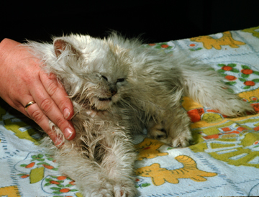
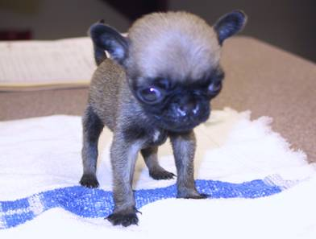
HYDROCEPHALUS
Congenital
Outflow obstruction
De Novo
Brain disappears

Slide 5
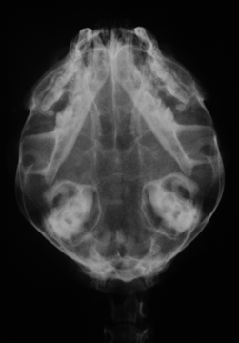
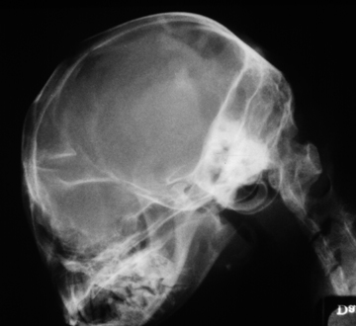
HYDROCEPHALUS
DV
LAT

Slide 6
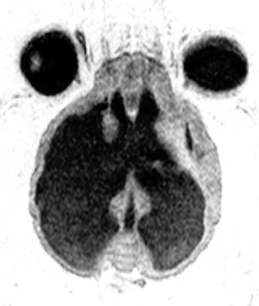
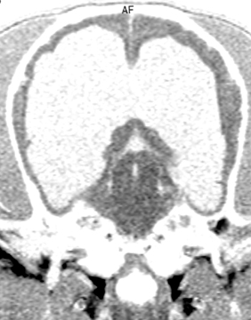
HYDROCEPHALUS
T2-horizontal
T1-coronal

Slide 7
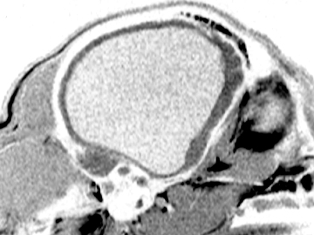
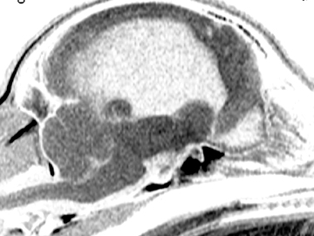
HYDROCEPHALUS
T1-sagittal (lateral)
T1-sagittal (midline)

Slide 8
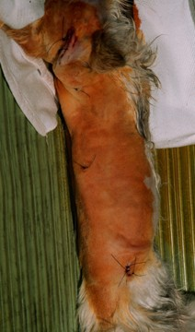
HYDROCEPHALUS
Medical Management
Antioxidants and Steroids
VentriculoPerotoneal Shunt
Helpful when progressive changes in neurologic status
TCVM treatment

Slide 9
Ventriculoperitoneal Shunt
Cranial end of shunt is placed through bur hole

Slide 10
Ventriculoperitoneal Shunt
Tunnel is made to bring shunt tubing to the abdomen

Slide 11
Ventriculoperitoneal Shunt
Abdominal end is pushed into abdomen using Kelly hemostats
Extra is left for growth or movement

Slide 12
TCVM Hydrocephalus
Kidney jing deficiency
Fails to support the development of marrow
Does not nourish the child (liver)
Does not control the grandchild (heart)
Insults the grandparent (spleen)

Slide 13
Hydrocephalus Patterns
Kidney & Spleen Qi Deficiency
Younger animals with congenital hydrocephalus
Kidney & Liver Yin/Blood Deficiency
Older animals with Canine Cognitive Disease
Liver Qi Stagnation
Secondary to CNS inflammatory disease or cancer

Slide 14
Jocko

Slide 15
Jocko
Problem List
Shen Disturbance
Hydrocephalus
Confirmed ultrasound
Hepatoencephalopathy
Confirmed BW
Overall poor development
TCVM
Tongue
thin-red
Pulses
Deep, weak fast particularly on right side
Diagnosis
Jing Deficiency
Yin deficient
Treatment
Hydrocephalus formula
Liu Wei Di Huang
Epimedium powder

Slide 16
Peanut’s Hydrocephalus Formula
Bai Zhi Angelica Dispel Wind-Cold, relieve pain
Bai Zhu Atractylodes Strengthen Spleen Qi
Ban Xia Pinellia Transform Damp and stops vomiting
Bo He Mentha Dispel Wind-Heat
Cang Zhu Atractylodes Dry up Dampness, strengthen Spleen Qi
Chan Tui Cicada Dispel Wind, move Qi to the head
Dang Shen Codonopsis Tonify Qi
Deng Xin Cao Juncus Clear Heat, Drain Damp-Heat
Fu Ling Poria Benefit the urination
Huang Qi Astragalus Tonify Spleen Qi and dissipate swelling
Jie Geng Platycodon Open to the Upper Jiao, transform phlegm
Jin Yin Hua Lonicera Clear Heat, detoxify
Ju Hua Chrysanthemum Clear Heat, detoxify
Shan Yao Dioscorea Tonify Spleen Qi
Sheng Ma Cimcifuga Clear Wind-Heat, move Qi to the head
Ze Xie Alisma Benefit the urination
Zhi Ban Xia Pinellia Transform Damp and stops vomiting
Zhu Ling Polyporous Benefit the urination

Slide 17
Epimedium Powder
Epimedium Yin Yang Huo Tonify Kid Yang/Jing, Promote Sexual Desire
Cuscuta Tu Si Zi Tonify Kid Yang, Jing & Yin
Cistache Rou Cong Rong Tonify Kid Yang & Yin
Paeonia Bai Shao Yao Nourish Liver Yin & Blood
Polygonum He Shou Wu Nourish Blood & Jing, Benefit Hair
Actinolite Yang Qi Shi Tonify Kid Yang
Cynomorium Suo Yang Tonify Kid Yang
Psoralea Bu Gu Zhi Tonify Kid Yang & Strengthen Bones
Dipsacus Xu Duan Tonify Kid Yang & Promote Fracture Healing
Lycium Gou Qi Zi Nourish Liver Yin, Benefit Eyes
Condonopsis Dang Shen Tonify Qi
Astragalus Huang Qi Tonify Qi
Rehmannia Shu Di Huang Nourish Kid Yin & Jing
Angelica Dang Gui Nourish Blood
Ophiopogon Mai Men Dong Moisten & Nourish Yin
Scrophularia Xuan Shen Cool Blood & Clear Heat
Citrus Chen Pi Move Qi & Relieve Pain

Slide 18
5 year old Siberian Husky

Slide 19
De Novo Hydrocephalus

Slide 20
Pierre
15 yr old M poodle
Owner went on vacation
Boarded at facility
Upon return ataxia that progressed to coma in 8 hours

Slide 21
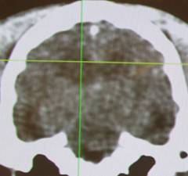
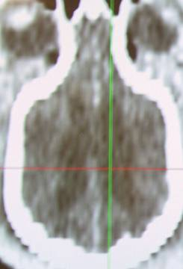
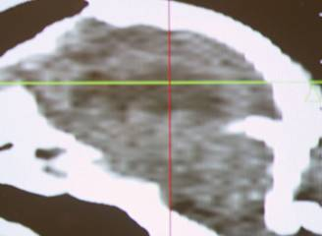
Pierre

Slide 22
Husky & Pierre
Problem List
Shen Disturbance
Hydrocephalus
Confirmed MRI/CT scan
TCVM
Tongue
thin-red
Pulses
Deep, weak fast particularly on right side
Diagnosis
Liver & Kidney yin deficiency
Treatment
½ Dose Hydrocephalus formula
Liu Wei Di Huang
½ Dose Epimedium powder

Slide 23
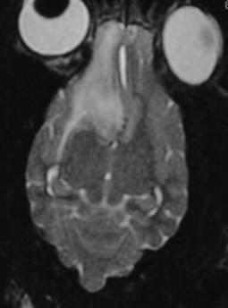
CNS Neoplasia
Today’s Frontier

Slide 24
CNS Neoplasia- -Dogs
Common Types
Meningioma
Astocytoma
Oligodendroglioma
Choroid plexus papilloma
Lymphoma
Neuroectodermal tumors
Metastatic tumor

Slide 25
CNS Neoplasia- -Dogs
Dog has 1-18 months average survival time
1-3 with nothing
6-9 with surgery
12-18 with radiation treatment
All tumors are invasive (malignant)

Slide 26
CNS Neoplasia- -Cats
Most common is meningioma
Usually extra-axial and benign
Seen in aged cats
Present with depression and dementia

Slide 27
Elvis

Slide 28
Elvis
MRI revealed mass in the cerebral cortex

Slide 29
Elvis

Slide 30
Treatment
Prednisolone (0.25-0.5 mg/kg q12h)
Treats secondary effects
Cover with gastroprotectants
Chemotherapy
Radiation therapy

Slide 31
Chemotherapy
Lomustine
60 mg/M² given
Monitor CBC weekly
If WBC and platelets okay in 5 weeks, then give 80 mg/M²
Repeat every 5-8 weeks
Procarbazine
2-4 mg/kg/day for 1 week, then 4-6 mg/kg/day
Monitor CBC
Continue as long as WBC levels are > 4000/µl & platelet count is > 100,000/µl

Slide 32
Chemotherapy
5-hydroxyurea
Meningiomas
50 mg/M² given
Monitor CBC weekly
Repeat every 3-4 weeks
Melatonin
Gliomas
0.1-0.2 mg/kg once a day in the evening
Reduces growth of many tumors by 50%

Slide 33
Treatment
Diet
Low carbohydrate
Supplements
Antioxidants & membrane stabilizers
Herbal medications
Western- -Canine Cancer formula
Traditional Chinese medicine- -Stasis in the Mansion of the Mind

Slide 34
Blood Stagnation
Hz:
Acute Seizures
Head Injury
Tongue
red & greasy
Pulse
Fast, wiry & slippery
Rx Principle
expel phlegm, extinguish the wind, open the orifice, stabilize the seizures and invigorate blood
AP
CV-15, ST-40, PC-5, HT-7, LI-11, LIV-3, An Shen, Da Feng Men
TCM Herbal
Ding Xian Wan
TCVM Cancer Treatment

Slide 35
Stasis in Mansion of Mind
Angelica Bai Zhi Warm the Channel, relieve pain
Pinellia Ban Xia Transform phlegm
Ligusticum Chuan Xiong Move Blood
Salvia Dan Shen Move Blood
Lumbricus Di Long Clear Wind, invigorate Channel
Ligusticum Gao Ben Relieve pain
Pueraria Ge Gen Bring Qi upward
Carthamus Hong Hua Break down Blood Stasis
Bombyx Jiang Can Transform phlegm, resolve nodule
Scorpion Quan Xie Break down Blood Stasis
Cimicifuga Sheng Ma Ascend Qi
Fritillary Zhe Bei Mu Transform phlegm, resolve nodules
Scolopendra Wu Gong Detoxify, resolve nodules

Slide 36
Max’s Formula
Bai Zhi Angelica Clear Wind-Cold and relieve pain
Da Huang Rheum Clear stagnation/stasis and clear Heat
Jie Geng Platycodon Open the Upper Jiao and transform phlegm
Mu Li(Shu) Ostrea Soften hardness and clear mass
Tian Hua Fen Trichosanthes Clear Heat and promote body fluids
Xia Ku Cao Prunella Clear Liver Heat and resolve nodules
Xuan Shen Scrophularia Clear Heat and cool Blood
Zhe Bei Mu Fritillaria Soften hardness and clear nodules

Slide 37
Wie Qi Booster
Bai Hua She She Cao Oldenlandia Inhibit cell mutation and tumor growth
Ban Zhi Lian Scutellaria Inhibit cell mutation, inhibit tumor growth
Chen Pi Citrus Move Qi and transform phlegm
Dang Gui Angelica Tonifies Blood
Dang Shen Codonopsis Tonify Qi and boost Wei Qi
Huang Qi Astragalus Tonifies Qi in whole body and Wei Qi
Wu Yao Lindera Move Qi and clear stagnation
Xuan Shen Scrophularia Cool Blood and nourish Yi

Slide 38
Stasis Breaker
Bai Hua She She Cao Oldenlandia Inhibit cell mutation and tumor growth
Ban Zhi Lian Scutellaria Clear Heat-toxin, inhibit cell mutation,
inhibit tumor growth
E Zhu Zedoaria Purge the interior, break Blood stasis and
clear mass
Mu Li(Shu) Ostrea Soften hardness and clear mass
San Leng Sparganium Purge the interior, break stasis and clear
mass
Zhe Bei Mu Fritillaria Soften harness and clear nodules

Slide 39
Jerry
10 year old, Mx
Progressive loss of coordination and head tilt
Personality change
Tongue: purple
Pulse: fast & wiry

Slide 40
Jerry
Neurologic Exam
Left head tilt
Positional, vertical nystagmus
Mild CP deficits in rear L>R
Xextensor R -> L in rear
Localization
L Cerebellar pontine angle with cerebral signs

Slide 41
Jerry
TCM Dx:
Liver Blood Stagnation
TCM Rx:
Stasis in Mansion of Mind
Wie Chi Booster

Slide 42
Jerry- -MRI scan

Slide 43
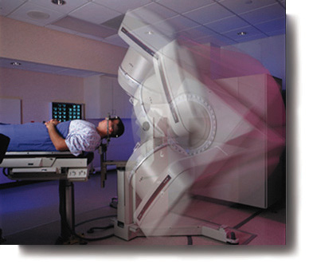
Radiosurgery (3D radiation therapy)
McKnight Brain Institute at UF
High, single dose radiotherapy
5 arcs of radiation provide sphere of death
Based upon the focal size and tissue treated

Slide 44
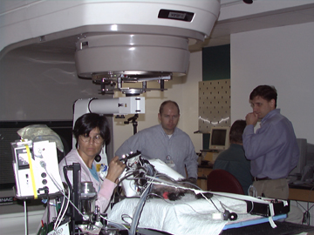
Radiosurgery- -Treatment
Treatment is applied with LINAC unit at UFBI
Cost of radiosurgery
procedure is around $3000.00
plus workup & conventional surgery

Slide 45
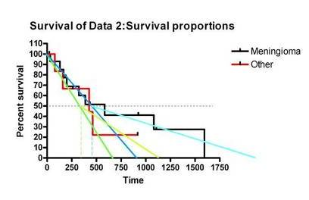
Radiosurgery Success
Overall ED50 is around 13 months
Some patients survive much longer
Prognosis for meningiomas is better than others

Slide 46
Cancer Recommendations
Low-Carbohydrate food (home prepared is best or use Pedigree Weight Loss Formula)
Canine basic antioxidant formula (Westlab Pharmacy 1-800-4WESTLA)
Canine arthritis formula (Westlab)
Canine cancer formula (Westlab)- -use at 2 times prevention dose
COX-2 inhibitor (daily- -particularly for carcinomas)
Melatonin at night (0.1-0.2 mg/kg)

Slide 47
TCVM Brain Cancer
Max Formula
Stasis in Mansion of Mind
Wei Qi Booster
Western herbs
or
Transports to Head
and
and

